Slide 1
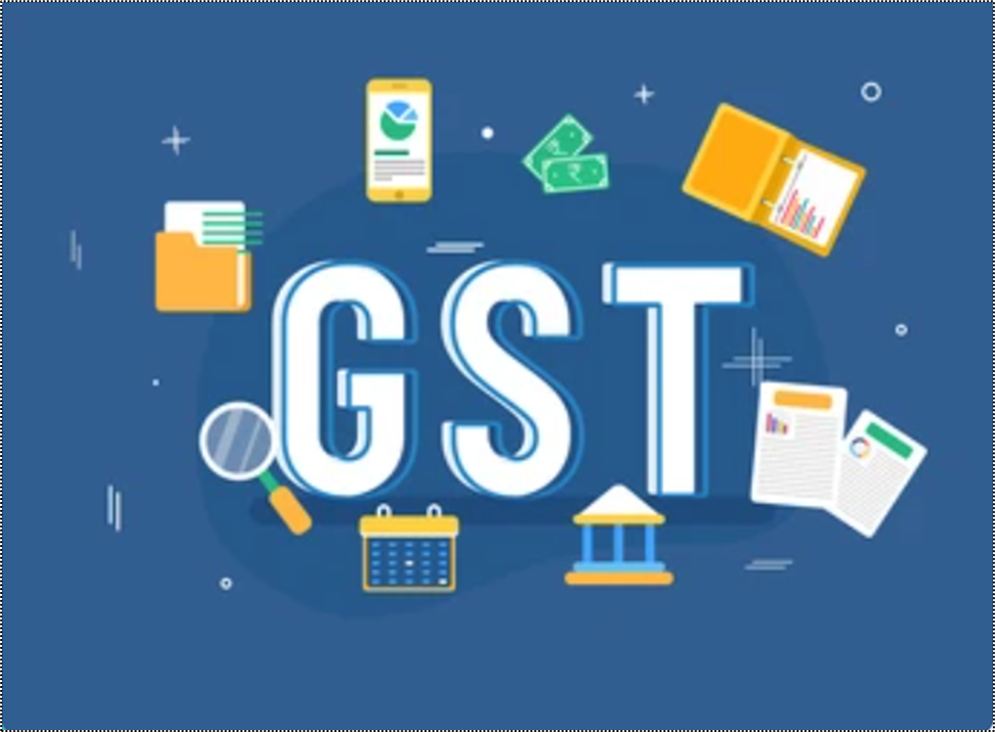
GST – Goods & Service Tax

Slide 2



Introduction to GST
Goods and Services Tax (GST) is a comprehensive indirect tax levied on the supply of goods and services in India. Under GST, both the Central and State Governments share the authority to levy and collect taxes on goods and services.
The GST system follows a dual structure, comprising Central GST (CGST) and State GST (SGST), levied concurrently by the Central and State governments, respectively. Additionally, an Integrated GST (IGST) is levied on interstate supplies and imports, which is collected by the Central Government but apportioned to the destination state
The GST Council plays a crucial role. The Council makes decisions on various aspects of GST, including tax rates, exemptions, and revenue sharing between the Central and State Governments.
The Central Government was committed to providing compensation to the States for any revenue shortfall during the initial years of GST implementation. This compensation was meant to bridge the gap between the expected revenue growth and the actual revenue collected by the States.

Slide 3
Benefits of GST
One Nation, One Tax - Uniformity in the tax structure across India, eliminating the cascading effect of taxes
Dual Structure dual structure, comprising the Central GST (CGST) levied by the Central Government and the State GST (SGST) levied by the State Governments
Destination-based Tax- GST is a destination-based tax, levied at each stage of the supply chain, from the manufacturer to the consumer.
GST
Increased Compliance and Transparency - The transparent nature of the tax system, helps in curbing tax evasion and increasing transparency.
Input Tax Credit (ITC) GST allows for the utilization of input tax credit. This helps avoid double taxation and reduces the overall tax liability

Slide 4

Existing Indirect Tax Structure in India - subsumed under GST
Central Tax
State Tax
Central Excise duty
Additional duties of excise
Excise duty levied under Medicinal & Toilet Preparation Act
Additional duties of customs (CVD
& SAD)
Service Tax
Surcharges & Cesses
State VAT / Sales Tax
Central Sales Tax
Purchase Tax
Entertainment Tax
Luxury Tax
Entry Tax (All forms)
Taxes on lottery, betting & gambling
Surcharges & Cesses
GST

Slide 5




Tax Structure - Goods Not Covered under GST

Slide 6
GSTIN Format & Registration Type

Slide 7
GSTIN Format
2 | 9 | A | A | A | C | P | 7 | 8 | 7 | 9 | D | 1 | Z | 0
Character | Meaning
First two digits | State Code
Next 10 digits | PAN allotted to the business
13th digit | The number of registrations in a state (It's a combination numeric/alphabetic code, with digits 0 through 9 preceding the letters A through Z)
14th digit | Default character (The 14th digit is a default that is determined by the type of company. The letter Z is used to indicate a typical taxpayer)
Last digit | Checksum digit or number

Slide 8
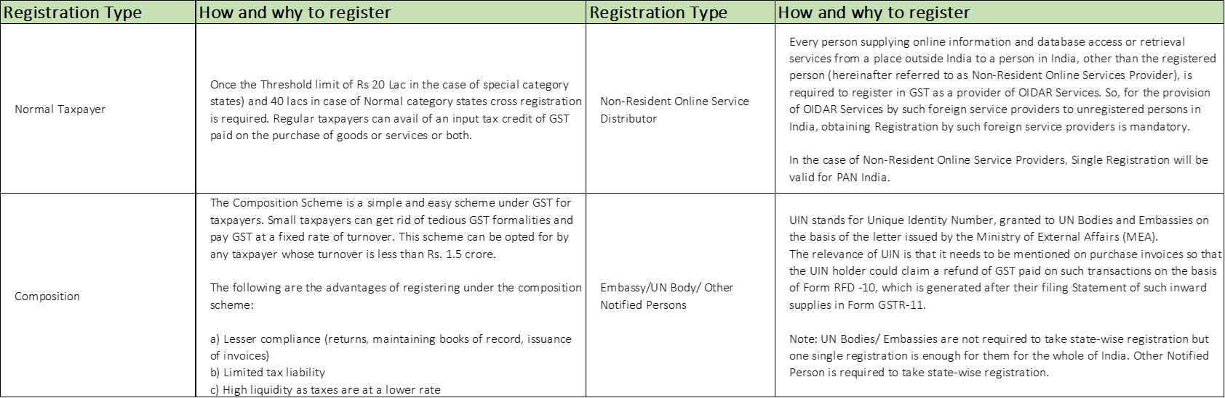
Registration Type

Slide 9
Registration Type

Slide 10
Tax Structure
CGST
SGST
IGST
UTGST
Stands for Central Goods & Service Tax
Stands for State Goods & Service Tax
Stands for Integrated Goods & Service Tax
Stands for Union Territory Goods & Service Tax
Tax collected by Central Government
Tax collected by State Government
Tax collected is shared between Centre and State
Tax collected by Union Territory
Applicable on supplies within the state
Applicable on supplies within the state
Applicable on interstate and import transactions
Applicable on supplies within the Union Territory
Cess charged for special goods which is calculated based on either value, quantity, or both

Slide 11
Value of Supply - Goods / Services

Slide 12
Value of Supply - Goods / Services
The value of taxable supply of goods and services shall be ‘the Transaction Value’.
It refers to the price actually paid or payable for supply of Goods and Services
Added to Transaction Value
Deducted from Transaction Value
Commission
Packing
Insurance
Any other tax other than GST
Interest or late fee or penalty for delayed payment of any consideration for any supply
Subsidies directly linked to the price excluding subsidies provided by the Central and State governments
Discount mentioned in the invoice
Post Supply discount known before supply and can be linked to invoice

Slide 13
Place of Supply

Slide 14
Place of Supply for GST
Under GST, the existing system of levy of tax on manufacture, provision of taxable services, and sale of goods will be replaced by the concept of ‘Supply’. It is very important, therefore, to understand the “place of supply” meaning in determining the right charge of tax on supply. The buyer place is always POS irrespective of sending goods to any other consignee or third party!
In an intra-state supply, the taxes to be charged are CGST and SGST.
In an interstate supply, the tax to be charged is IGST. The following are also treated as interstate supplies:
Import of goods or services
Export of goods or services
Supply of goods or services to or by a SEZ developer or SEZ unit, even if the supply is within the state.
Supplies under section 7 of IGST Act
Courier or mail service provided to a local consignee even-through its foreign party which is the actual buyer.

Slide 15



Place of Supply - Goods
Supply Involves Movement of Goods
Place of Supply is the location at which the movement of goods terminates for delivery to the recipient
Karnataka
Ganesh Trading Ltd
IGST
Tamil Nadu
Interstate Supply
Place of Supply

Slide 16

Place of Supply - Goods
Bill To Ship To
Place of Supply will be principal place of business of Third person
Telangana
Andhra Pradesh
Karnataka
Interstate Supply
Ganesh Trading Ltd
Place of Supply
Ramesh Trading Ltd
IGST
Tamil Nadu

Slide 17
Place of Supply - Goods
Bill To Ship To
Place of Supply will be principal place of business of Third person
Telangana
Andhra Pradesh
Karnataka
Intra-State Supply
Ganesh Trading Ltd
Place of Supply
Ramesh Trading Ltd
CGST+SGST
Tamil Nadu

Slide 18
Place of Supply - Services
Supply of services to Registered Person
Place of supply will be the place of Registered Person
CGST+SGST
Place of Supply
Karnataka
Intra State Supply
Mangalore
Advertising Service Provider
Bengaluru
Interstate Supply
Tamil Nadu
IGST
Place of Supply

Slide 19
Place of Supply - Services
Supply of services In Relation to Immovable Property
Place of supply will be location at which immovable property is located
CGST+SGST
Karnataka
Intra State Supply
Deluxe Hotel
Place of Supply
Tamil Nadu
Mr. SAM

Slide 20
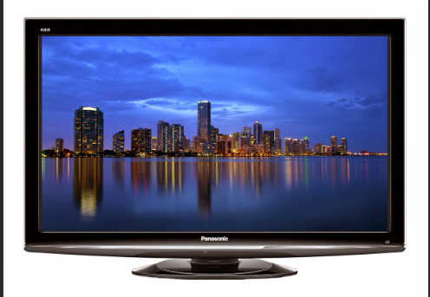


Scenario to understand Place of Supply
Mr. Raj Sold TV to Mr. Vinod
Mr. Raj of Mumbai, Maharashtra
Mr. Vinod of Bangalore, Karnataka
Bangalore – Different State
IGST
Place of supply?
GST to be charged

Slide 21

Scenario to understand Place of Supply
Mr. Raj of Mumbai, Maharashtra
Mr. Raj Sold 5 TV ‘s to Ms. Vijaya
Ms. Vijaya of Nagpur, Maharashtra
Nagpur – Same State
CGST + SGST
Place of supply?
GST to be charged

Slide 22

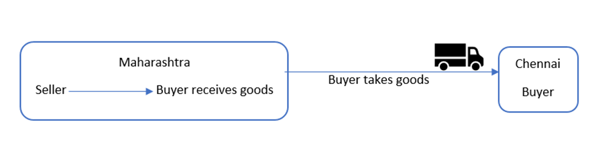
Scenario to understand Place of Supply
Buyer & Seller are in Maharashtra, wherein Buyer further transports the goods to Chennai on his own!
It is immaterial whether the receiver further transports the goods to his place of business or elsewhere, but the Seller sold goods in Maharashtra is considered a POS
Place of Supply: Maharashtra, hence CGST + SGST will be charged

Slide 23


Scenario to understand Place of Supply
Mr. Vinod of Bangalore, Karnataka
Mr. Raj Sold TV to Mr. Vinod
Mr. Raj of Mumbai, Maharashtra
Mr. Vinod instruct Mr. Raj to deliver TV to Ms. Rita as Gift
IGST
Bangalore – Different State
Ms. Rita of Nagpur, Maharashtra
Place of supply?
GST to be charged
Here, only Goods is being shipped, however, the ITC will be availed by Vinod, hence IGST will be charged
Notes:
Goods

Slide 24
GST Rates & HSN/SAC Code

Slide 25
GST Rates
The percentage rates of tax imposed on the sale of goods or services under the GST Act. A business registered under the GST law must issue invoices with GST amounts charged on the supply value.
Zero Rated/ Exempt (0%)
Essential items including food
Fresh meat, fish chicken, eggs, milk, butter milk, curd, natural honey, fresh fruits and vegetables, flour, besan, bread, prasad, salt, bhindi. Sindoor, stamps, judicial papers, printed books, newspapers, bangles, handloom
Merit Rate (5%)
Commonly used items
Skimmed milk powder, branded paneer, frozen vegetables, coffee, tea, spices, pizza bread, rusk, kerosene, coal, medicines
Standard Rate (12%, 18%)
Bulk of the goods and services. This includes fast-moving consumer goods.
Mobile Phones, butter, cheese, ghee, dry fruits in packaged form, sausage, fruit juices, namkeen, coloring books, picture books, Notebooks, steel products, printed circuits, camera, speakers, monitors, flavored refined sugar, pasta, cornflakes, pastries and cakes, preserved vegetables, jams, sauces, soups, ice cream, instant food mixes, mineral water, tissues etc.
Demerit Rate (28%) + Additional Cess
Pan masala, aerated water, paint, deodorants, shaving creams, after shave, hair shampoo, dye, sunscreen, wallpaper, ceramic tiles, water heater, dishwasher, weighing machine, washing machine, ATM, vending machines, vacuum cleaner, shavers, hair clippers, automobiles, motorcycles
Luxury cars, tobacco, and aerated drinks
Chapter V (3%)
Gold (including gold plated with platinum) unwrought or in semi-manufactured forms, or in powder form, Base metals, silver or gold, clad with platinum, not further worked than semi-manufactured
Jewellery
Additional cess on luxury items which attracts based on value or quantity and for few both

Slide 26
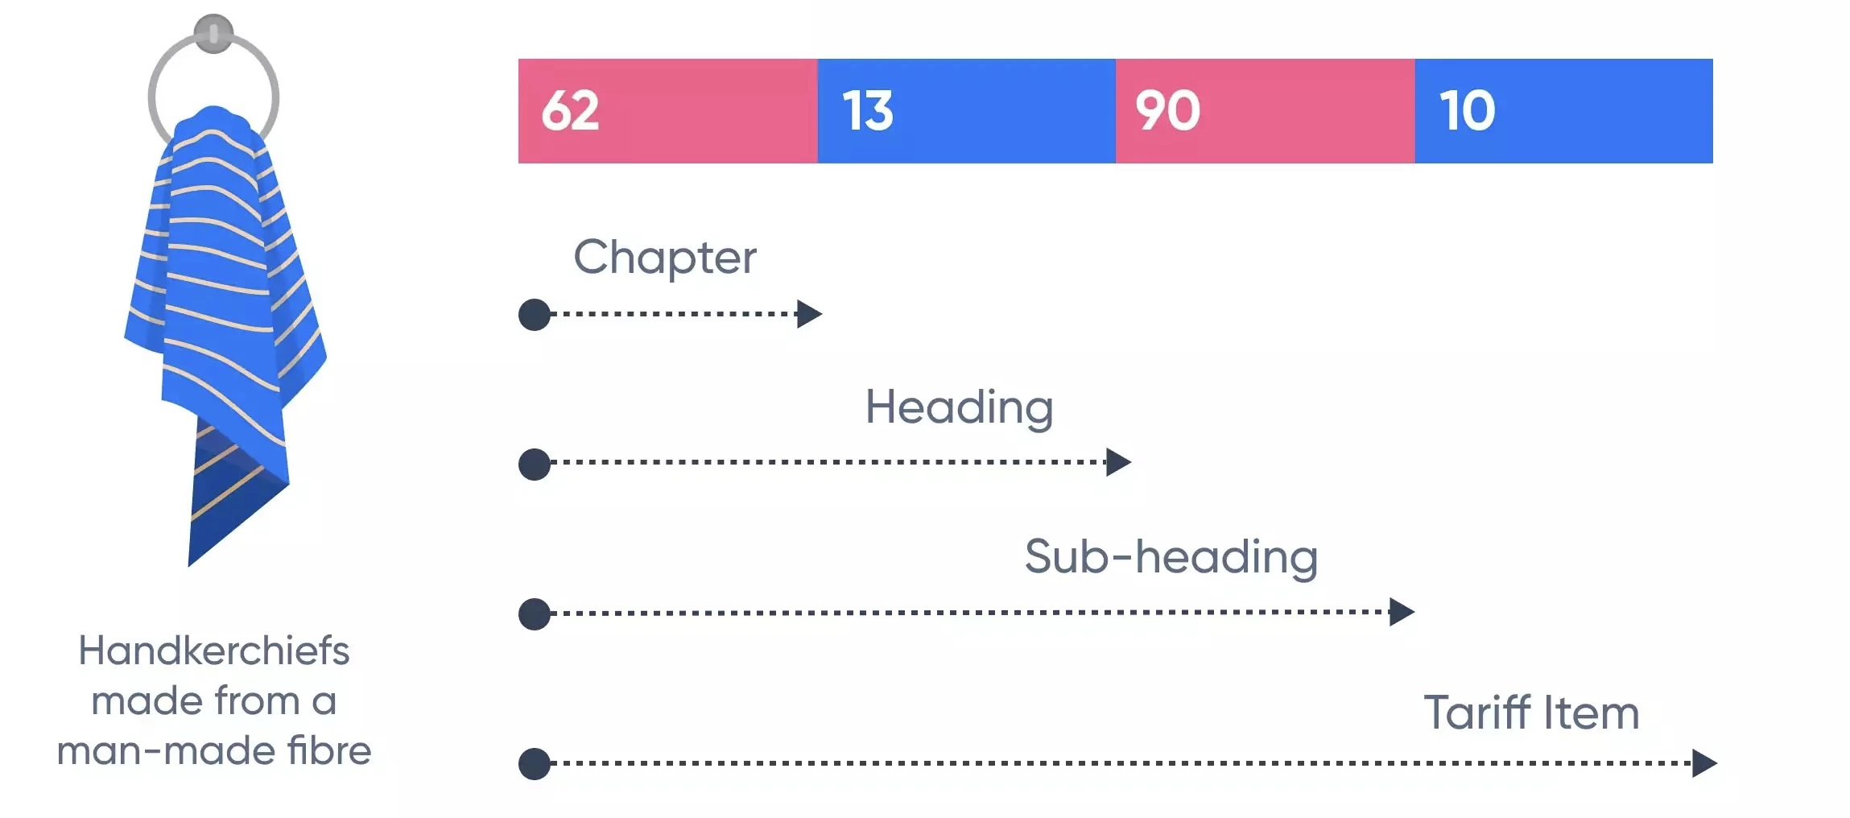

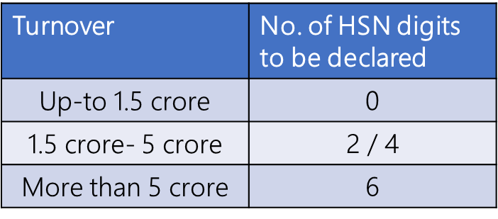
HSN - Harmonized System of Nomenclature
The main purpose of HSN is to classify systematically and logically. This brings in a uniform classification of goods and facilitates international trade.
The HSN structure contains 21 sections, with 99 Chapters, about 1,244 headings, and 5,224 subheadings.
Each Section is divided into Chapters.
Each Chapter is divided into Headings.
Each Heading is divided into Sub-Headings.
HSN always start with other than “99”
Structure of HSN Code

Slide 27
SAC - Services Accounting Code
Like goods, services are also classified uniformly for recognition, measurement and taxation. Codes for services are called Services Accounting Codes or SAC
Services are classified as per the Services Accounting Code (SAC). The SAC is strictly numeric and is 6 digits.
The first two digits are the same for all services i.e. 99
The next two digits (82) represent the major nature of service, in this case, legal services
The last two digits (13) represent the detailed nature of service, i.e., legal documentation for patents, etc.,

Slide 28
GST Invoicing

Slide 29
GST Invoices
When a registered taxable person supplies taxable goods or services, a GST invoice is issued. To issue and receive a GST-compliant invoice is a prerequisite to claim ITC. If a taxpayer does not issue such an invoice to his customer - who is a registered taxable person, his customer loses the ITC claim, and the taxpayer loses its customers.
Debit Note / Credit Note – Purchase / Sales Returns / Price escalations / de-escalations
Tax Invoice – Issue to registered dealer billed with Taxable Items
Bill of Supply - Issued for exempted goods or services / Paying tax under the composition scheme
Delivery Challan
Transportation of goods for job work
Receipt Voucher
Professional receipt / Invoice
Reverse Charge Invoice
Subject to Reverse Charge
Export Invoice
'"Supply meant for export on payment of IGST" or "Supply meant for export under bond or letter of undertaking without payment of IGST"
Type of Invoices

Slide 30
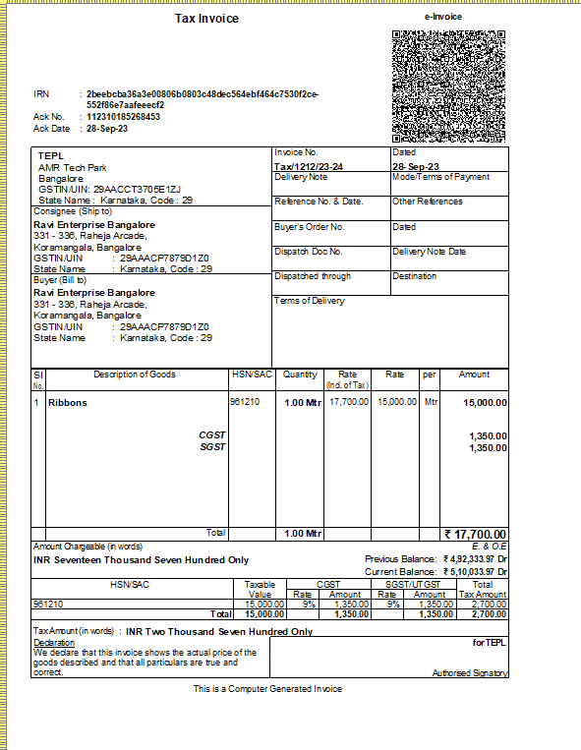
GST Invoices
Details to be captured in the GST invoice format
Invoice number and date
Customer name
Shipping and billing address
Customer and taxpayer's GSTIN
Place of supply
HSN code
Taxable value and discounts
Rate and amount of taxes i.e. CGST + SGST/UTGST (intra-state) OR IGST (inter-state)
Item details i.e. description, unit price, quantity
QR code in case supplier is under the purview of e-Invoicing
E-way bill in case its fulfills e-way bill condition

Slide 31
GST Invoices - No of copies of the GST invoice required
Supply of Goods
Original invoice: The original invoice is issued to the receiver and is marked as 'Original for the recipient'.
Duplicate copy: The duplicate copy is issued to the transporter and is marked as 'Duplicate for transporter'. This is not required if the supplier has obtained an invoice reference number.
Supply of Services
Original Invoice: The original copy of the invoice is to be given to the receiver and is marked as 'Original for the recipient'.
Duplicate Copy: The duplicate copy is for the supplier and is marked as 'Duplicate for supplier'.
Triplicate copy: This copy is retained by the supplier and is marked as 'Triplicate for supplier'.
Value of Supply – Goods / Service

Slide 32
Input Tax Credit (ITC)

Slide 33


Input Tax Credit (ITC)
To avail of input tax credit under GST, a dealer needs to meet the following conditions
ITC can be availed by every registered taxable person on all inputs used or intended to be used in the course of or for the furtherance of business – be it goods or services. Similarly, ITC will also be available on capital goods used in the course of business, except for a few exceptions.
Must possess a Tax Invoice / Debit or Credit Note / Supplementary Invoice issued by the supplier
Must have received the goods/services
Must have filed returns (GSTR 3B)
Must ensure that the tax charged has been paid to the government by the supplier
Must have completed invoice matching and reflect in GSTR-2B to avail final ITC else need to be reversed

Slide 34
Input Tax Credit (ITC Utilization) Rules
Rule 1
Credit can be utilized to pay off the liabilities in a given sequence
(a) IGST input tax credit shall first be utilized towards payment of IGST liability and the amount remaining, if any, may be utilized towards the payment of CGST, SGST/UTGST liabilities in any order, before utilizing the CGST, SGST/UTGST credit.
(b) CGST input tax credit shall first be utilized towards payment of CGST liability and the amount remaining, if any, may be utilized towards the payment of IGST liability. CGST credit shall be utilized only if IGST credit is not available.
(c) SGST/UTGST input tax credit shall first be utilized towards payment of SGST/UTGST liability and the amount remaining, if any, may be utilized towards payment of IGST liability (if no CGST credit is available). SGST/UTGST credit shall be utilized only if IGST credit is not available.
(d) CGST input tax credit cannot be utilized towards payment of SGST/UTGST liabilities and SGST/UTGST input taxed credit cannot be utilized towards payment of CGST liabilities.
Rule 2
ITC cannot be utilized for payment of reverse charge liabilities
Rule 3
Rule 4
ITC can’t be utilized for payment of TDS/TCS/interest/penalty/fee/others.
ITC can be utilized for payment of tax only.
Rule 5
The amount allowed to be entered for utilization of credit can’t be more than the amount of balance available in the Electronic Credit Ledger.

Slide 35
Company Configuration

Slide 36
GST Company configuration
Single GSTIN with one company
F11: Configuration
Multiple GSTIN
F11: Configuration > Enable Multi Address with Multi-GSTIN
Multiple Company with same GSTIN
F11: Configuration
Creating Masters of GST, Party, Revenue and non-revenue ledgers
Creating Masters of GST, Party, Revenue and non-revenue ledgers, voucher type specific to their addresses.
Creating Separate companies with relevant address
Creating Masters of GST, Party, Revenue and non-revenue ledgers, voucher type specific to their GSTIN.
Sync the data to get consolidated GST report
Generate separate GSTIN wise report to upload the same!

Slide 37
GST Sales Cycle

Slide 38
Business-specific type of Sales Transactions - Basic
Professional
Supply of Services – Local / Interstate
Retailer or Trader
Supply of Goods – Local / Interstate
Accounting Item Invoice / Accounting Invoice
Accounting in Invoice Mode & Voucher Mode
Multiple GST Rates for different services
Consumer / B2C Service
Multiple GST Rates for Different Goods
GST Sales of Service with Discount
Inclusive of GST for Services
Professional service through Receipt voucher (Single entry System)
GST Sales with Discount
Supplies when Buyer and Consignee are Different
Inclusive of GST for Goods
Actual & Billed
Recording Sales escalation/de-escalation in Price / Returns
Service delivered on behalf of the local or interstate party
Invoices with MRP Inclusive of Tax
Invoice with Exempt, NIL Rated goods
At Item Level
As Discount Ledger
GST in POS Invoice

Slide 39
GST Advance Receipts & its Adjustment
An enhanced experience of Advance Receipts & Payments (Provision to set-off advances in the Sales & Purchase)
Master Setup
Advance Opening Balance
Transaction Setup-Off Experience
Report Experience
MIS Report

Slide 40
GST Advance Receipts & its Adjustment
Master Setup
Press F11 (Company Features) > Set/Alter Company GST Rate and Other Details: Yes
Show GST Advances for adjustments in transaction: Yes.
Transactions Experience
Provide Opening Balance for Unadjusted GST Advances Received
Raise Tax Liability for Advances Received
You will be able to set off GST advance receipts in sales invoices right from the Applicable from date.
Record GST Advance Receipts in TallyPrime
Set off GST advances received in sales invoice
Report Experience
Outstanding Advance Receipts
Basis of Value & F12 configuration

Slide 41
Business-specific type of Sales Transactions - Advance
Voucher class for GST
Other Business Nature
Exports
Retailer or Trader
Supplies with MRP Inclusive of GST
Slab Rate with or without additional expense apportioning
High Sea Sales
Supplies with Cess – On Quantity and Value
Sale of Mixed Supply
Sale of Fixed Asset
GST on TCS Sales
Supplies Through e-Commerce Operator
Supply of Works Contract Services
Solar and Renewable Energy Projects
GST Classification

Slide 42
Business-specific type of Sales Transactions - Advance
Refer to the script to explain each use case!

Slide 43
GST Purchase Cycle

Slide 44
Purchase Transactions
Purchases of Goods – Local / Interstate
Accounting Item Invoice / Accounting Invoice
Business Expenses
Purchases when Supplier and Consignee are Different
Multiple GST Rates for Different Goods
Purchase of Fixed Asset
Business Expenses
GST on Purchase with TDS
Trading or Manufacturing Purchases
High Sea Purchase
RCM Purchases of Goods & Services
Payment Vouchers
Journal Vouchers
Expense through Purchases
Ineligibility of Tax Credit During Purchases
Separate Adjustment for ineligible ITC
Imports

Slide 45
RCM – Reverse Charge Mechanism

Slide 46
Reverse Charge Mechanism
Other facts
Date of receipt of goods; or
Date of payment as per books of account or date of debit in bank account, whichever is earlier;
Every tax invoice has to mention whether the tax in respect of supply in the invoice is payable on reverse charge.
Similarly, this also needs to be mentioned in the receipt voucher as well as the refund voucher, if tax is payable on reverse charge.
Registration
A person who is required to pay tax under reverse charge has to compulsorily register under GST and the threshold limit of Rs. 20 lakhs (Rs. 10 lakhs for special category states except (J & K) does not apply to them.
Introduction
Reverse charge is defined as “liability to pay tax by the recipient of supply of goods or services or both instead of the supplier of such goods or services or both on any imports and other notified supplies listed by GSTIN
ITC – Input Tax Credit
Suppliers cannot take ITC of GST paid on goods or services used to make supplies on which the recipient is liable to pay tax.

Slide 47
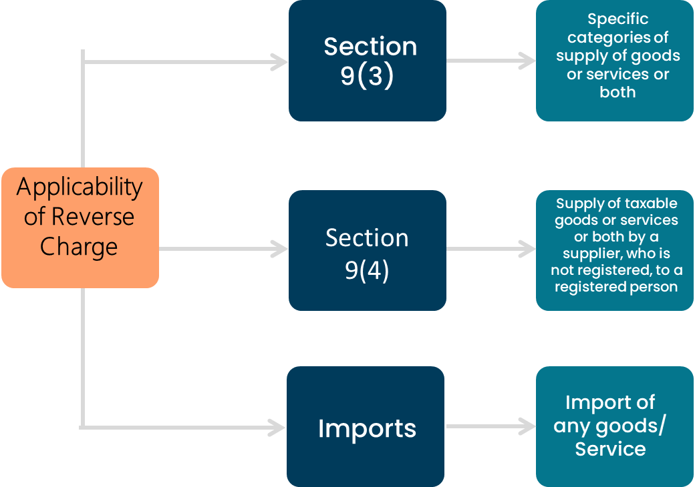
Supplies of goods under reverse charge mechanism
Goods
Services
GTA Services
Legal Services by advocate
Services provided by way of sponsorship to any body corporate or partnership firm
Services supplied by an arbitral tribunal to a business entity
Services supplied by a recovery agent to a banking company a financial institution or a non-banking financial company
Cashew nuts, not shelled or peeled
Bidi wrapper leaves (tendu)
Tobacco leaves
Silk yarn
Raw cotton
Section 9(4) has been deferred since Oct’2019 wherein any purchases from URD – RCM are not applicable and considered as Exempt

Slide 48
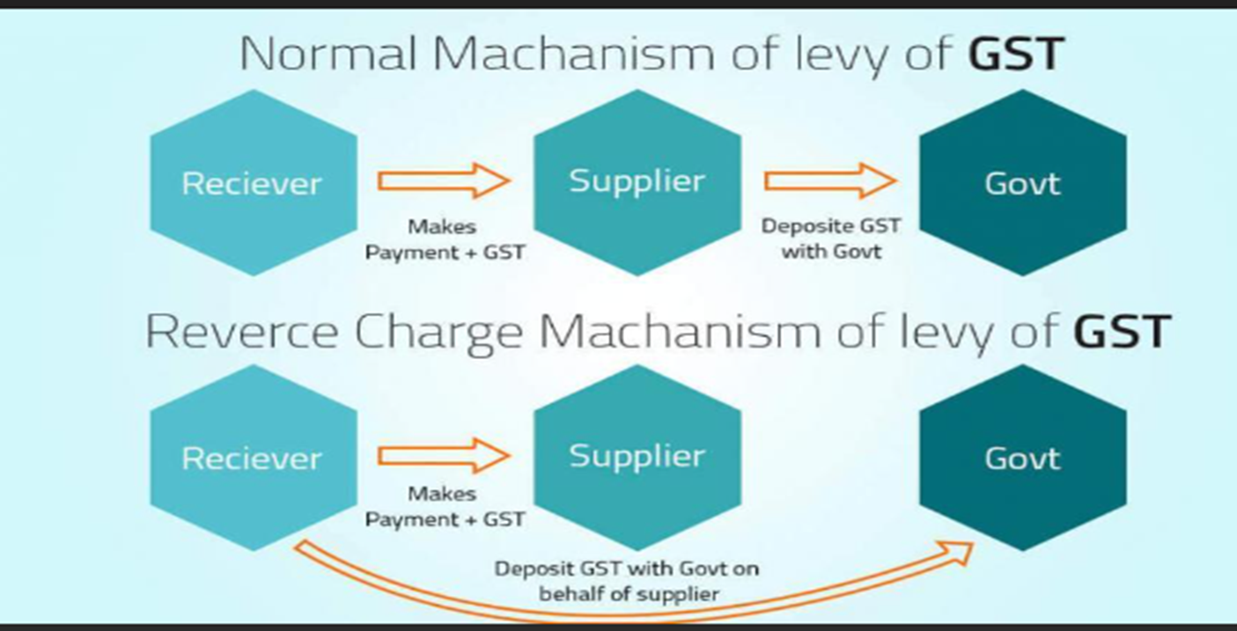
Reverse Charge Mechanism Flow

Slide 49


Supplies of goods under reverse charge mechanism
Is RCM applicable for this Advocate Service? if so, who is liable to pay GST
Handle Legal Case of Karan Batra
Karan registered GSTIN Pays Rs.25,000/- as Legal Charges
As its Legal charges paid to Advocate which is liable US/ 9(3) – Listed service, Karan has to pay GST to GSTIN as part of RCM!
ABC Advocate & Associates – GST Registered

Slide 50



Supplies of goods under reverse charge mechanism
Is RCM applicable for this transport? if so, who is liable to pay GST
Commuting to Office
Hires Taxi - Unregistered
As Taxi Driver is not registered, it will not be part of Section 9(4) and as it’s a regular taxi service i.e.., transportation of passengers by Taxi is an exempted service.
Rajat – GST Registered

Slide 51



Scenario to apply Reverse Charge Mechanism
Sachin (based in Bangalore) registered with GSTIN
Is RCM applicable for this Consultancy Service? if so, who is liable to pay GST
Provides Consultancy Services
As Ranjan provides inter-state service, he should mandatorily get registered under GST to provide RCM Service!
To provide inter-state service, Mr. Rajan would be required to get registered. And once, he gets registered, this would be a transaction between Rajan and Sachin both of whom are registered under the GST, and Sachin pays the liability .
Rajan (based in New Delhi) not registered with GSTIN

Slide 52
Record reverse charge purchases – Goods / Services
Record inward supply of goods/service purchases under reverse charge
Payment of RCM to GSTIN
Alt+G (Go To) > press F5 (Payment)
Alt+J. - Stat Adjustment Details
Nature of Payment: Payment under Reverse Charge
Record purchase with item / accounts invoice will participate in 3.1 Tax on Outward and Reverse Charge Inward Supplies
02
04
01
03
05
Create Stock / Service Master with RCM Enabled
Raise Tax Liability and Claim Input Tax Credit
Adjust ITC against existing liability
GST Rate Details >
Applicable for Reverse Charge: Yes
Not Shown - press F12 (Configure) > Enable Reverse Charge calculation to Yes.
Alt+G (Go To) > press F7 (Journal)
Alt+J. - Stat Adjustment Details
Nature of Adjustment: Increase in Tax Liability & Input Tax Credit
Additional Nature of Adjustment: Purchase Under Reverse Charge from Registered Dealer, if URD – then Purchase from Unregistered
Alt+G (Go To) > press F7 (Journal)
Alt+J. - Stat Adjustment Details
Nature of Adjustment: Decrease in Tax Liability
Additional Nature of Adjustment: Others
Notes:
If you want to claim ITC in the subsequent month, then select Increase in Tax Liability. Thereafter, you will need to create a journal voucher in the subsequent month with Nature of Adjustment as Increase in Input Tax Credit.

Slide 53
Imports
In case of suppliers outside of India and importing/purchasing of goods from them are considered import of goods, are similar to inter-state supplies and attract integrated tax (IGST). Additionally, you have to pay Customs Duty on such purchases. All the taxes and duties on import of goods are paid on a reverse charge basis, that is, the liability to pay tax is on the recipient of the supply of goods instead of the supplier.
Importing goods attracts integrated tax. Customs Duty is applicable on such purchases. All the taxes and duties on import of service are paid on a reverse charge basis, that is, the liability to pay tax is on the recipient of the supply of goods instead of the supplier.
Customs Duty can be added to the Taxable Value of your import of goods in the Purchase voucher, by overriding the taxable value.
Or Payment towards Customs Duty and Integrated Tax – Custom duty can be added to the cost of purchase
Claim Input Tax Credit for Tax Paid on Imports
Notes:
https://help.tallysolutions.com/tally-prime/gst-adjustment-transactions/india-gst-journal-vouchers-in-gst-tally/

Slide 54
Take away on reverse charge Mechanism
RCM is applicable on the listed Goods & Services under section 9(3) and for Imports
For Interstate RCM – Good / Services, the Service Provider should get mandatorily registered
The service receiver or recipient will pay the liability to GSTIN and then avail the ITC
In case of Purchases from URD, same is deferred and considered as Exempt, however, if RCM listed goods / Service, then the recipient needs to pay GST, if registered!

Slide 55
GST Adjustment

Slide 56
GST Adjustments Entries in TallyPrime
GST Nature of Adjustment
Decrease in Tax Liability
Increase in Input Tax Credit
Increase in Tax Liability
Increase in Tax Liability & Input Tax Credit
Reversal of Input Tax Credit
Actual liability of GST is reduced which can be due to Purchase from URD, RCM, adjustment against Advance, etc.,
ITC increased due to the Import of Goods, Services, RCM, reclaim of ITC
Actual liability of GST is increased due to late fees, interest, advance receipt, and ISD credit notes.
Recording both liability and ITC for Import of Service, URD Purchase, RCM Purchases
Exempted Supplies, Non-Business Supplies, Non-payment to supplier, ineligible ITC, etc.,
Notes:
https://help.tallysolutions.com/tally-prime/gst-adjustment-transactions/india-gst-journal-vouchers-in-gst-tally/

Slide 57
GST Adjustments Entries in TallyPrime
Credit –CGST / SGST / IGST
Debit – Expense / Party / Current Assets
Credit – Expense / Party / Current Assets
Debit – CGST / SGST / IGST
Debit – Expense / Party / Current Assets
Credit – CGST / SGST / IGST
Debit – CGST / SGST / IGST
Credit – Expense / Party / Current Assets
Tax Liability
Input Tax
Tax Liability
Input Tax
In case both liability and ITC are to be accounted for, then irrespective of the adjustment flag – CGST/SGST /IGST will be credited or debited
Notes:
https://help.tallysolutions.com/tally-prime/gst-adjustment-transactions/india-gst-journal-vouchers-in-gst-tally/

Slide 58
GST Returns

Slide 59
GST Returns - Regular
Value of Supply – Goods / Service
GSTR-1
GSTR-3B
GSTR-9
GSTR 9C
Details of the outward supply of goods or services are to be filed monthly or quarterly.
Monthly return containing details of taxes collected on outward supplies and details of taxes paid on input supplies.
GSTR 9 is an annual return to be filed once in a year by the registered taxpayers under GST
Return of registered person whose annual turnover exceeds ₹ 2 Crore whose a/c is under audit

Slide 60
GSTR-1

Slide 61
GSTR-1 – Due date is on 11th
Form GSTR-1 is a monthly/quarterly Statement of Outward Supplies to be furnished by all Regular and casual registered taxpayers making outward supplies of goods and services or both and contains details of outward supplies of goods and services.
Every registered taxable person, other than an input service distributor/ composition taxpayer/ persons liable to deduct tax u/s 51 / persons liable to collect tax u/s 52 is required to file Form GSTR-1, the details of outward supplies of goods and/or services during a tax period, electronically on the GST Portal.
Form GSTR-1 can be prepared using the following modes:
1. Online entry on the GST Portal.
2. Uploading of invoice and of Form GSTR-1 data using Returns Offline Tool.
3. Using third-party applications through GST Suvidha Providers (GSPs).

Slide 62
GSTR-1 Return filing – Modes of filing
User can generate and file return in the following formats
Generate JSON file using TallyPrime and upload on the portal
Generate JSON file using GST Offline Tool (Convert Excel or CSV File) and upload on the portal
File GSTR-1 directly on the portal
Through Connected GST, user can now upload, reconcile and file GSTR-1 from Tally 5.0 onwards

Slide 63
GSTR-1 Return filing - Prerequisites for Filing GSTR-1
System related
Internet connectivity: An active internet connection is required for uploading the JSON file, and for filing your returns.
General GST requirements
Microsoft Office: To use the GST Offline Tool and MS Excel for filing returns, then GSTN recommends MS Excel 2007 or later for exporting data to MS Excel.
GSTR-3B filing: Ensure that GSTR-3B returns are filed regularly. If GSTR-3B is not filed for the previous two return periods, then GSTN will block the filing of GSTR-1 as well.
HSN Summary: As per Rule 59(6) and Advisory on HSN & GSTR-1 filing shared by GSTN, it is mandatory to provide complete details of the HSN Summary with a minimum 6 digits if turnover is >5 Crore for filing returns.
Data Readiness
Resolving Uncertain Transactions for smooth GSTR-1 Filing

Slide 64
GSTR Uncertain Transaction/Exceptions
Resolving Uncertain Transaction/Exceptions

Slide 65
Uncertain Transactions to be resolved
Why
Easy preparation for filing
What
The GSTR report comes with an easy, intuitive classification of all GST-related errors classifying
How
You can drill down from the Uncertain Transactions section to view such uncertain details and correct them easily. Even if you have hundreds or thousands of transactions, it will be pretty easy to find and fix a particular error. This will ensure that you have a smooth filing experience.
Invalid or Missing Information of Masters
Mismatch between Master and Transactions
Mismatch within Transactions
Tax and other Adjustment

Slide 66
GSTR-1 Return filing: Understanding Uncertain Transactions Filing
Invalid or Missing Information
GST Master Related: Company/ Party - GSTIN details, registration type, etc.,
Stock item Master Related: HSN, UOM, GST Rate, etc.,
Voucher Related: Voucher Number, Tax Ledger, Effective date, Transaction Period, Amount/ GST rate overridden, etc.,
Summary Transactions
Amendments effective date
Mismatch between Master and Transactions
Expected tax vs modified tax
GST registration in party master vs in transactions
GST Tax rate in the master vs in Transactions
Mismatch within Transactions
Place of supply of Party vs Nature of supply
Conflicting Nature of Transaction
Tax and other Adjustment
Entries accounted with other voucher types – Tax or adjustment flag mapping is not done

Slide 67
GSTR-1 Return filing: Resolving Top Uncertain / Exceptions
Resolve Top Uncertain Exceptions

Slide 68
GSTR-1 Return filing: Resolving Top Uncertain / Exceptions
Filing GSTR-1

Slide 69
File GSTR 1 – Due on 11th
Generate the JSON file from TallyPrime
Export GSTR-1 to MS Excel or CSV format
Use the GST Offline Tool
Import data and generate the JSON file
Note: In case the customers using Release 2.1 and below need to recommend to upgrade to latest Release
File returns directly on the GST portal
Connected GST Returns
Upload GST Returns
Download & Reconcile GST Returns
File GSTR-1

Slide 70
GSTR-1 Return filing
Connected GST

Slide 71
Connected GST – All about “Exchanging Data”
Enable API Access
Upload GST Returns
File GSTR-1
Alt+Z: Exchange > File GSTR1 > shows the summary > click on send and Filing through EVC / DSC
Enabling GSTIN for API access and connect Tally to GSTN
Z: Exchange > Upload GST returns for selected return
One-time setup
Download & Reconcile
Configure GST Username in F11 (F11→ Enable GST → GST Registration Details) with Mode of signing
Performs dual activity ie., download and reconcile simultaneously

Slide 72
Enabling GSTIN for API access

Slide 73
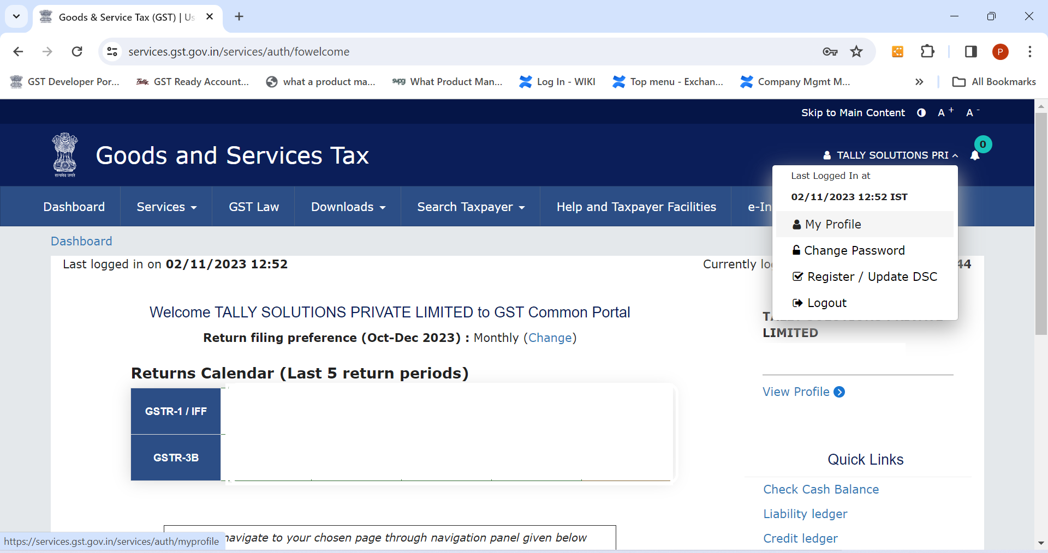
Enabling GSTIN for API access

Slide 74
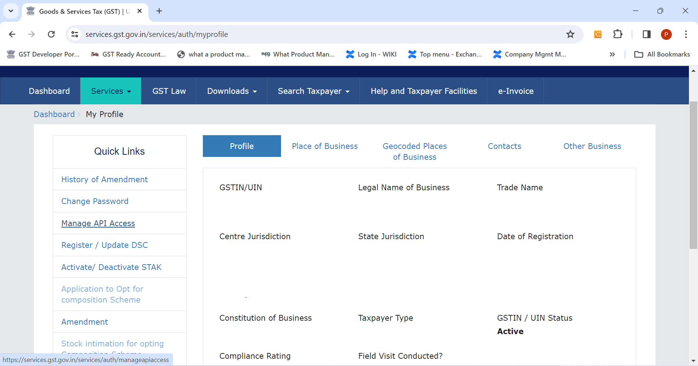
Enabling GSTIN for API access

Slide 75
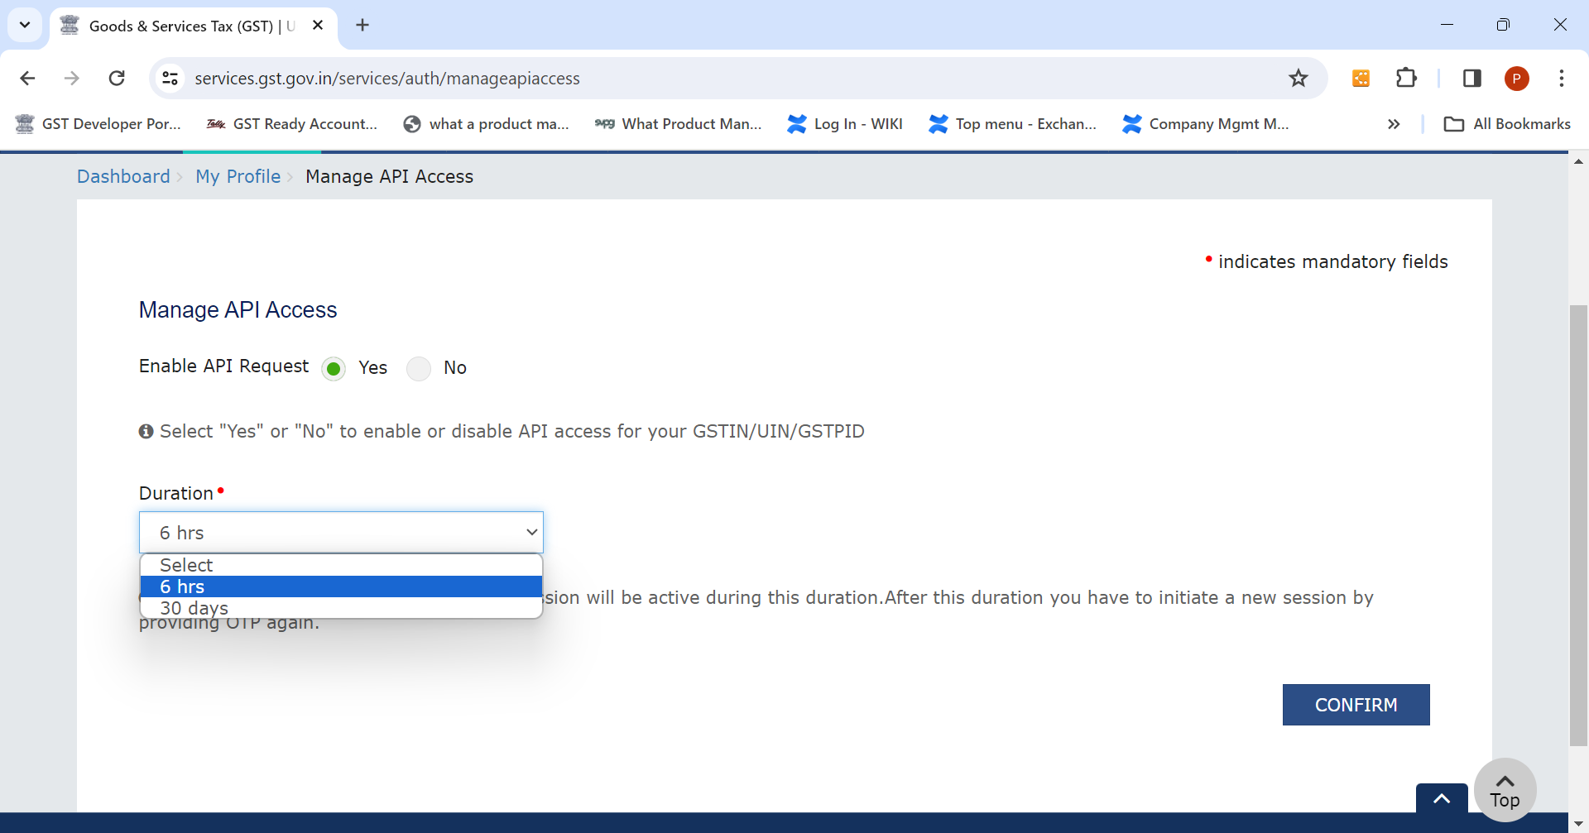
Enabling GSTIN for API access

Slide 76
One time configuration

Slide 77
One-time configuration in Release 5.0
Connected GST Details
Mode of filing
F11: GST Details > Connected GST Details > enter GST Username
Select the mode of filing as EVC: Electronic Verification code or
DSC: Using Digital Signature Dongle

Slide 78
Connected GST Experience

Slide 79
Connected GST – All about “Exchanging Data”
Upload GST Returns
File GSTR-1
Alt+Z: Exchange > File GSTR1 > shows the summary > click on send and Filing through EVC / DSC
Z: Exchange > Upload GST returns for selected return
Download & Reconcile
Performs dual activity ie., download and reconcile simultaneously

Slide 80
Upload GST Returns
Upload GST Returns
Users can either navigate from
Upload not completed
Preview report shows the vouchers that are failed as Rejected by the GST Portal
Or Go to GSTR-1/3B return > a new table Rejected by GST portal (to be uploaded) will be shown
Notification
When upload is in progress, user will be notified in Notification (bell ICON) to refresh the pending activities, also
In Alt+Z: Exchange, it will be as 'Upload GSTR-1' and in Alt+E: Export, it will be as 'GSTR-1 Returns’.
Alt+Z: Exchange (top menu button) or from Alt+E: Export (Top menu Button). OR
Shows return preview > Click on send to upload selected GSTR returns
Drill down on the same for necessary action majorly on
Invalid GSTIN
Invalid or Mismatch in HSN
In GSTR-1 a message Upload is pending for the current period. Press Alt+Z: Exchange > Refresh GST Status will be shown to upload pending transactions
Notes:
For IFF return incase of AMJ – wherein only April – B2B is to be uploaded, there was a period difference, for which a configured in preview mode > F12: Consider report period instead of Return filing period for Online upload has been provided, which will be a consistent behavior once configured.

Slide 81
Download GST Returns
Download
Download GST Returns to Reconcile
Download & reconcile returns for
Multiple Registration / For multiple GST Returns / For Multi Period
Only specific returns to download can be configured in Alt+Z: Exchange > GST
Exchange
Exchange data from GST portal
Completes download and performs reconciliation for required form / selected form.
Upload / Download
Upload / Download Tracker
In F11: Help > Troubleshooting > Online upload/download tracker – a log which shows the activities which is permanent. F12: shows user wise and BOV: to know the activity, returns, activity, status, etc.,
Note: a) Tables 14-15 will not be displayed in the GSTR-1 Recon. However, for filing GSTR-1, the downloaded GSTR-1 e-commerce summary data will be shown before submission. b) The downloaded e-commerce summary will not be compared with the books, as this comparison is not supported

Slide 82
File GSTR-1 Return
Alt+Z: Exchange > File GSTR1 > shows the summary > click on send
Data processing / validating summary happens in three steps
Filing through EVC / DSC> Enter the PAN number of the authorized signatory
File summary
Download Summary
Downloaded Summary shown to user
Validate the data shown in a downloaded summary report and click on Continue filing
GSTR-1 successfully filed status will be shown with ARN Number and return filed status as “Filed”

Slide 83
GSTR-1 Files Summary / Download Summary
Once return is filed user can view the GSTR-1 Return field summary
Goto > check with GSTR-1 Filed Summary – Downloaded or type download summary
Use can also check download summary from GSTR1 > Change view
This shows Return month, Return filed summary with ARN & ARN Date

Slide 84
GST Filed Summary
Go To
After filing the GSTR-1 Return, users can review the GST filed summary by navigating to Goto and searching for the "GSTR-1 Filed Summary." or Download summary, which includes the ARN and ARN date
GSTR-1
In GSTR-1 Report > Change view > search for the "GSTR-1 Filed Summary."

Slide 85
GSTR-1 Return filing
Filing GSTR-1 – Offline Process

Slide 86
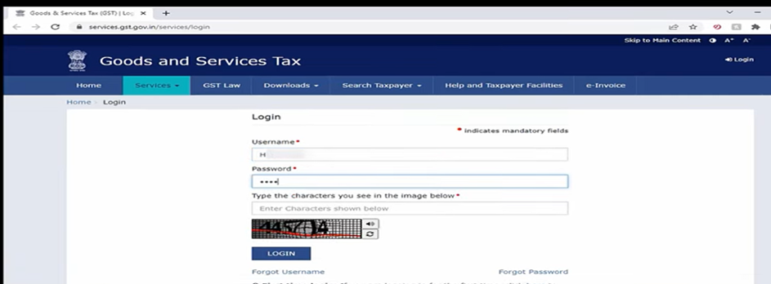
Uploading Return on GST Portal

Slide 87
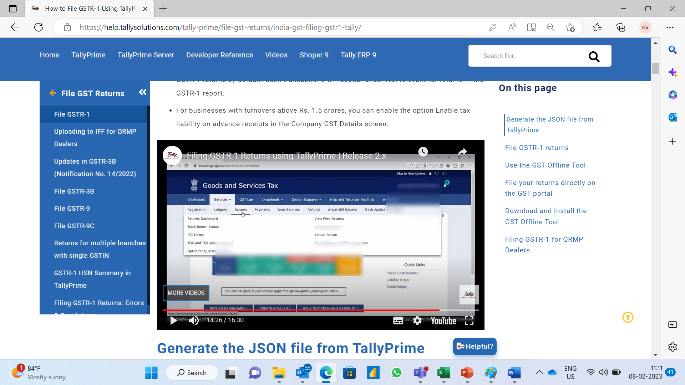
Uploading Return on GST Portal

Slide 88
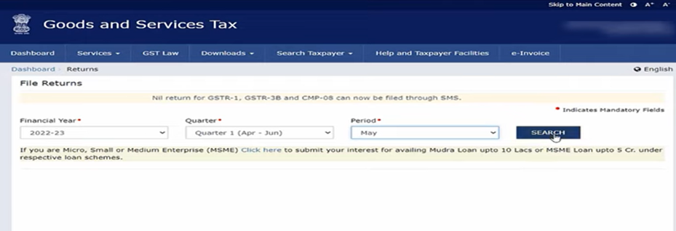
Uploading Return on GST Portal

Slide 89
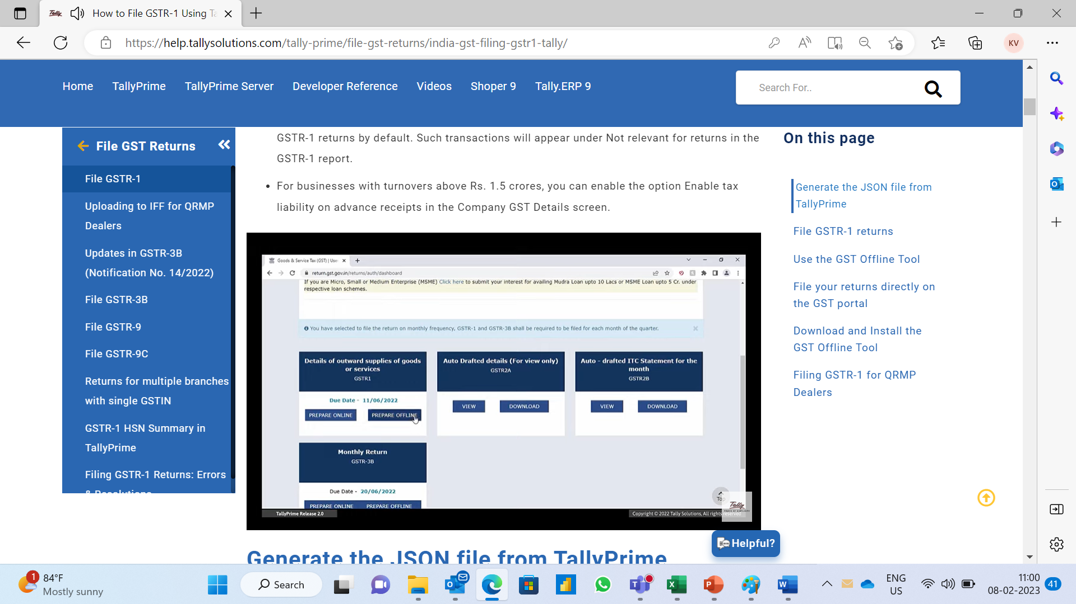
Uploading Return on GST Portal

Slide 90
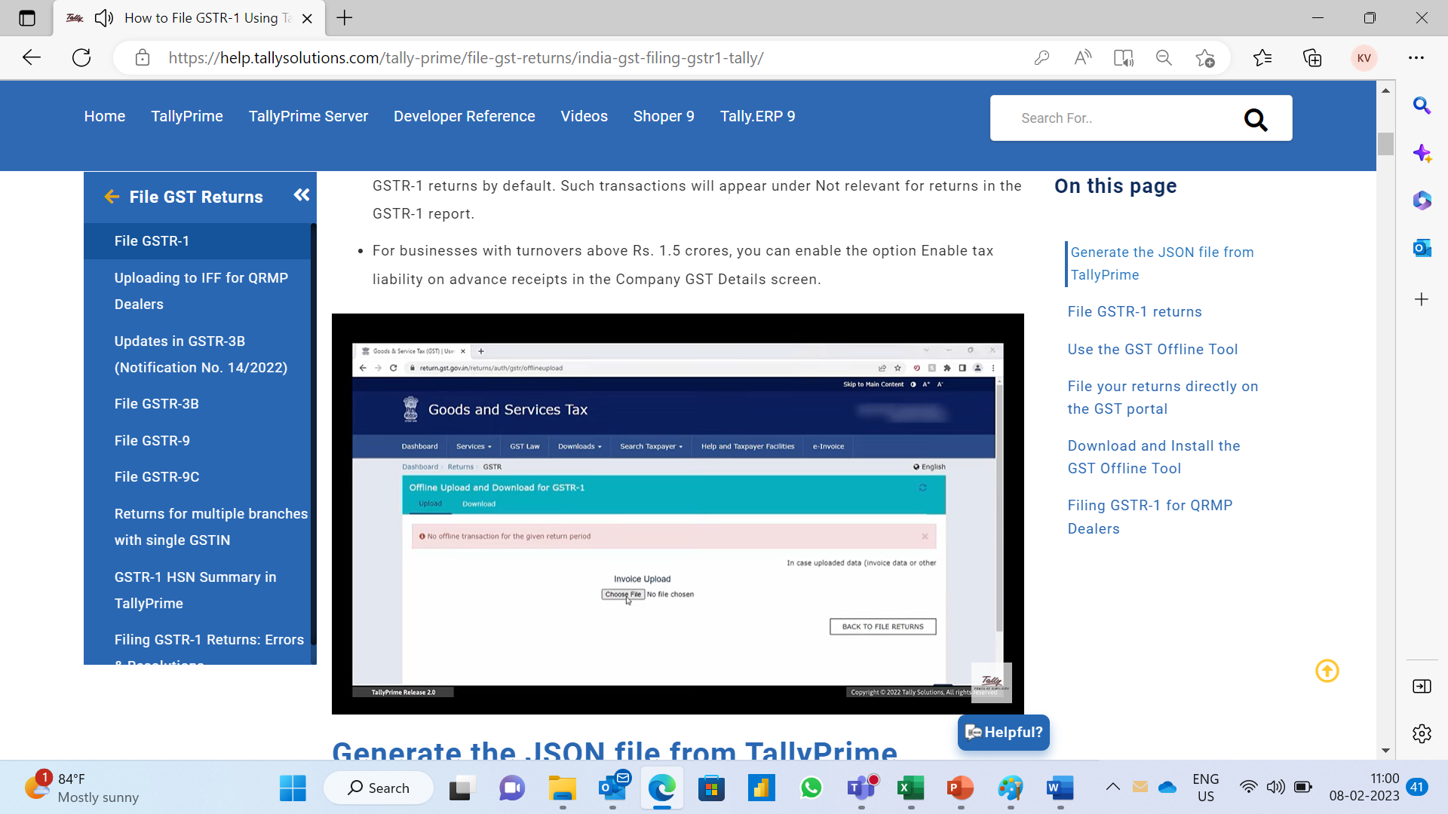
Uploading Return on GST Portal

Slide 91
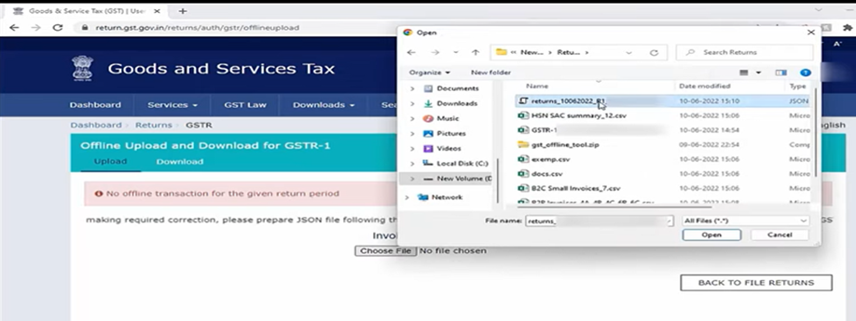
Uploading Return on GST Portal

Slide 92
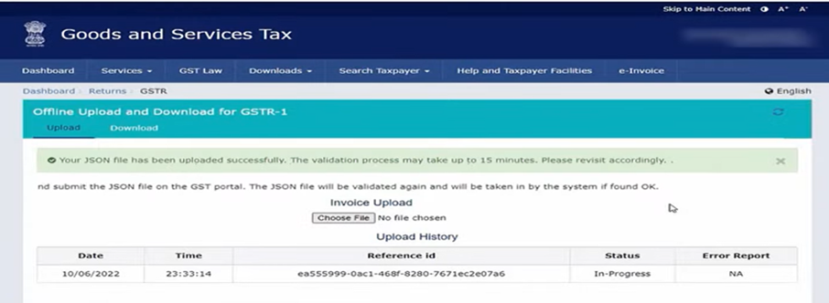
Uploading Return on GST Portal

Slide 93
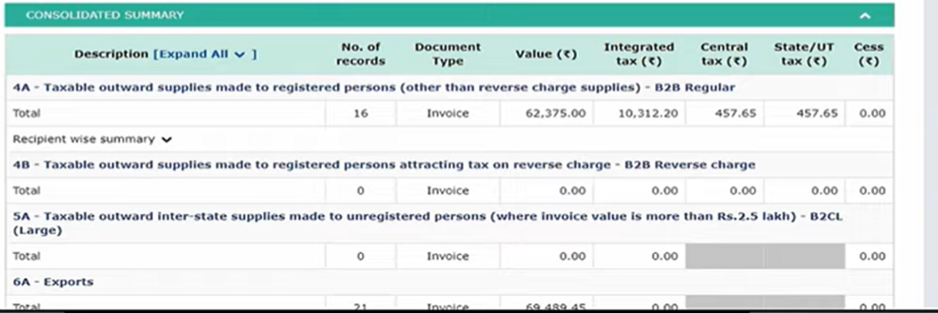
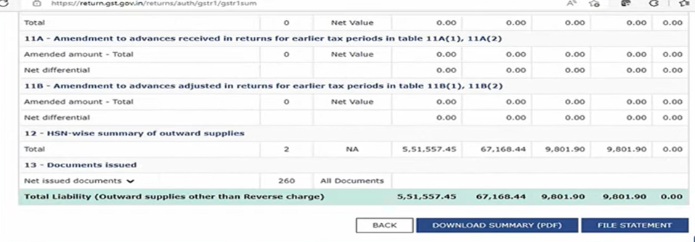
Uploading Return on GST Portal

Slide 94
Uploading Return on GST Portal & Signing Returns in Tally
Submit and e-sign returns on the GST Portal
Open GSTR-1 in Tally > F10: Marked as filed
This allows to track any modified transactions to amend the return for upcoming returns

Slide 95
File NIL Return

Slide 96
File NIL Return
1.
Alt+Z: Exchange > click on File GSTR-1 > Send
2.
The system warns that “Do you want to File NIL Return”
3.
Required message is shown and user is allowed to file “NIL Return”

Slide 97
GSTR-1 Return filing
GSTR-1 – IFF Return

Slide 98
GSTR-1 – Quarterly filing / IFF
Quarterly filing of Form GSTR-1
If your turnover during the preceding financial year was up to Rs. 5 Crore or
What to be uploaded?
B2B invoices and credit notes every month using the Invoice Furnishing Facility (IFF) provision on the GST portal, so that buyers can claim the Input Tax Credit in the first and second months. In the third month, you can file GSTR-3B and GSTR-1, as usual with all sections
If you are registered during the current financial year and expect your aggregate turnover to be up to Rs. 5 Crores
Sections to be uploaded
4A, 4B, 4C, 6B, 6C – B2B Invoices
9B – Credit/Debit Notes (Registered) – CDNR
9A – Amended B2B Invoice – B2BA
9C – Amended Credit/Debit Notes (Registered) – CDNRA

Slide 99
Process to file GSTR-1 – Quarterly filing / IFF – Connected GST
Ensure in F11: Periodicity of GSTR-1 is configured as quarterly
First three months of the quarter > F2: Period select respective month F12 > consider report period instead of return filing period for online upload.
After uploading Last month of the quarter > select the quarter period to upload pending summary and file the details on the portal.
Submit the return on the portal and update the status as “Marked as Signed” in Tally
Download the respective month for reconciling it and file the return directly on the porta for each month

Slide 100
Process to file GSTR-1 – Quarterly filing / IFF – Offline Mode
Ensure in F11: Periodicity of GSTR-1 is configured as quarterly
First three months of the quarter > F2: Period select respective month to export JSON file / upload GST return using Release 5.0
Last month of the quarter > configure the period for Quarter > Export JSON to upload the return
Submit the return on the portal and update the status as “Marked as Signed” in Tally

Slide 101
GSTR-3B
GSTR-3B

Slide 102
GSTR-3B – Due date on 20th
What is GSTR-3B?
Form GSTR-3B is a summary return for taxpayers to declare their GST liabilities for a particular tax period and discharge these liabilities. A Regular taxpayer is required to file Form GSTR-3B returns for every tax period.
Who has to file GSTR-3B?
All Regular taxpayers and casual taxpayers are required to file Form GSTR-3B
Modes of preparing Form GSTR-3B?
Form GSTR-3B can be prepared using the following modes:
1. Online entry on the GST Portal.
2. Uploading of invoice and of Form GSTR-3B data using Returns Offline Tool.
3. Using third-party applications through GST Suvidha Providers (GSPs).

Slide 103
GSTR-3B Return filing: Resolving Top Uncertain / Exceptions
Resolving exceptions of GSTR-1 will append in GSTR-3B, only Specific Inward related to GSTR-3B (Inward Supplies) to be Resolved!

Slide 104
Understand various export provisions to File GSTR-3B
Filing GSTR 3B
Online Mode
Export/ Convert to JSON
Offline Mode
Export Excel Format
Upload GST return using Rel 5.0
Upload to Portal

Slide 105
Process to file GSTR-3B – Connected GST Upload
Upload GST Returns
File GSTR-3B
Z: Exchange > Upload GST returns for selected return
Login to portal to file the GSTR-3B
Download & Reconcile
Performs dual activity ie., download and reconcile simultaneously

Slide 106
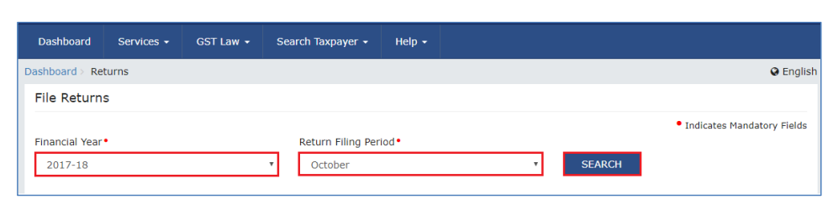
Uploading Return on GST Portal Online process
Access the www.gst.gov.in > click the Services > Returns > Returns Dashboard option.

Slide 107
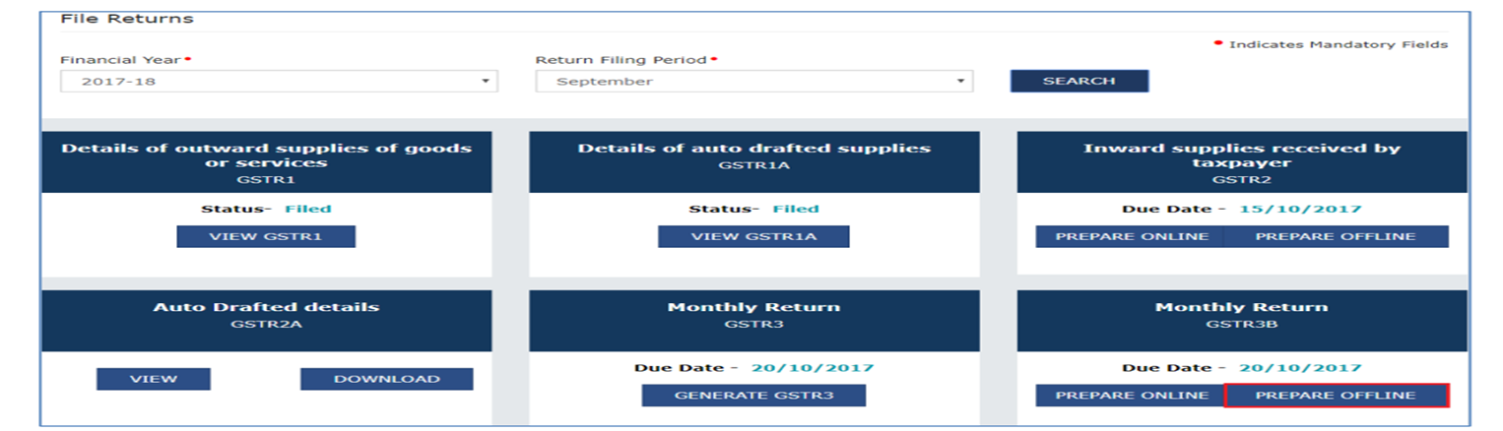
Uploading Return on GST Portal online process

Slide 108
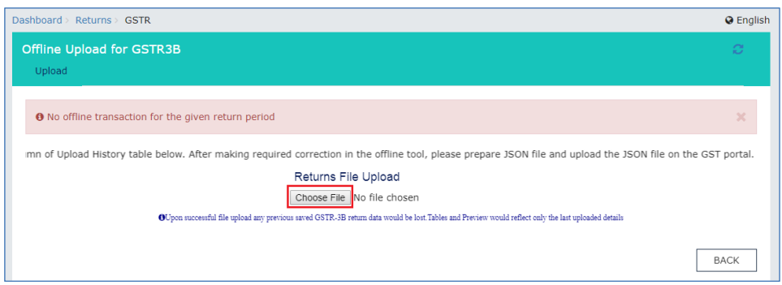
Uploading Return on GST Portal online process

Slide 109
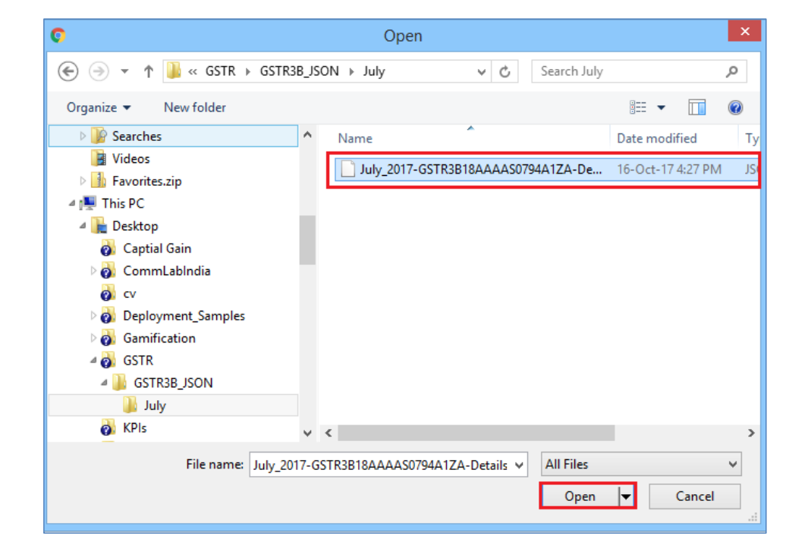
Uploading Return on GST Portal online process

Slide 110
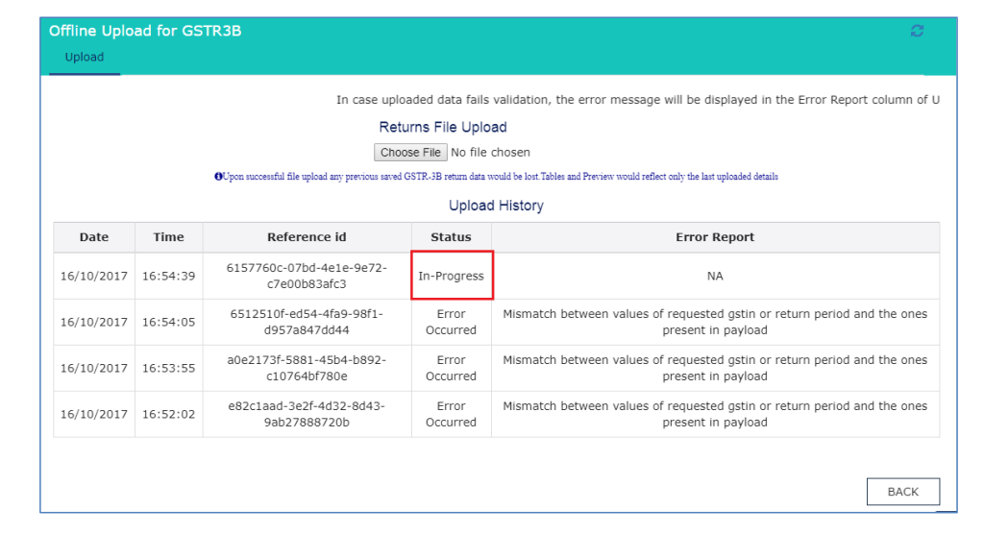
Uploading Return on GST Portal
Please Note
It is possible to upload JSON multiple times on the GST portal till submission. However, earlier uploaded data would be overwritten. Tables and Preview would reflect only the last data uploaded.
Post successful upload of data on the GST Portal, you can preview the form, submit it, Offset liability and file GSTR-3B

Slide 111
Uploading Return on GST Portal & Signing Returns in Tally
Submit and e-sign returns on the GST Portal
Open GSTR-3B in Tally > F10: Marked as Sign
This allows to track any modified transactions to amend the return for upcoming returns

Slide 112
GST Utilities
GST Rate Setup
Map UoM – UQC
Update Party GSTIN
One-stop report that will help to view or set up the GST rate details for all your relevant masters with great ease.
Update the GST Rate and HSN/SAC details for inventory masters, such as stock items and stock groups, and accounting masters, such as ledgers and groups.
Quickly update the GSTIN/UIN details for your parties' group-wise
User can update single or bulk GSTIN update using - Update Party GSTIN / Import Party GSTIN
UQC stands for Unique Quantity Code
UQC must be mentioned in e-invoices, e-way bills and when filling the HSN summary in GSTR-1.

Slide 113
Single / Bulk Ledger Creation

Slide 114
Single / Bulk Ledger Creation
Using the GSTN public API, users will have the option to create ledgers (individually or in bulk) as well as validate GSTINs from ledgers/transactions (individually) or from reports (in bulk).
This is a public API; it does not require login/session from the users.
HSN validation will continue using NIC APIs (existing behavior).
All the functionalities below are supported if GST is enabled in the company.
TSS is a MUST to perform this activity!

Slide 115

Single Ledger Creation - Ledger creation/alteration> Fetch details using GSTIN/UIN
Party details show Trade Name, address, Registration type, GSTIN Status
Alt+W: Update as per portal, allows the user to update the missing or override the data
PAN number will also get auto updated based on the GSTIN number
Alt+S: Filing History > Show details of the party with business details and also GSTR return filing status
Notes:
Whatever the previous ledger is configured, the group will be defaulted ie., if any bank ledger was created as a previous action when we create a new ledger with fetch details using GSTIN – grouping will shown as Bank group.
In case if the party is a government entity, then the Trade name will not be shown, however, the Legal name will be considered and the same will be filled as the ledger name
In case of multiple addresses, user can copy the address in alteration mode by enabling Multiple addresses and fetching the details

Slide 116
Bulk Ledger Creation – Chart of Accounts or GST utilities or Bulk or Multiple create (Goto)
01
02
03
It shows Party details with Trade Name, address, Registration type, and GSTIN Status PAN number will also get auto-updated based on the GSTIN number. History details can be checked for individuals using Compare GSTIN/UIN info
Import Excel with only GSTIN Number > option to import sheet name > column is also facilitated. List the GSTIN numbers which are imported > press Ctrl+A to import
In more details, for the selected party contact details and generic details can be provided

Slide 117
At Transaction level – Use cases!
While entering a purchase from the vendor – am not sure whether I get ITC, Party is still active, Party is still regular or canceled – to validate the status at multiple intervals this can be checked including filing status – wherein assurance of getting ITC can be reconfirmed.
The same applies for sale, so if the party is inactive or canceled, during creation, Party details can be changed to URD based on the status
For Cash sales doing B2B – wherein I don’t want to create a master use this to fetch and copy for that transactions – the same is required for buyer and consignee also can be provided.

Slide 118
Other Updates - Validate GSTIN/UIN and HSN/SAC Online – below 5.0
a) Validate GSTIN/UIN and HSN/SAC information online from within TallyPrime.
b) This facilitates quick online validation of GSTIN/UIN information for multiple parties and HSN/SAC information for multiple Stock Items in bulk.
1
Prerequisites for Online Validation (Till Release 4.1)
a) GST should be enabled in the Company in TallyPrime.
b) e-Invoicing e-Way Bill or both features should be enabled in TallyPrime.
c) Authentic with e-Invoice or e-Way Bill API login credentials
2
How does this help the user?
a) Authenticity of GSTIN/UIN information
b) Verify GSTIN on hand-written invoice
c) Avoid business with fraudulent vendors
d) Status of GSTIN / e-Way Bill
e) Convenience in verifying HSN/SAC information for Stock Items
3

Slide 119
Other enhancement / changes

Slide 120
Enhancement in GSTR-3B
GSTR-3B Reconciliation
GSTR-3B online reconciliation has been enhanced ie., it update or reconciles at the summary level with the sub-section level.
ITC Breakup
In GSTR-3B > F8: ITC Breakup - This helps the user to know;
a) ITC of the current period availed in the current period
Perform Sales recon in GSTR-1 and for purchases in GSTR-2B, so that it reconciles GSTR-3B automatically
b) ITC from other Periods availed in the current period
c) ITC Of the current period moved to other periods

Slide 121
GST Outstanding Reports

Slide 122
Ledger Outstanding
ITC Risk - Some use cases include:
If the return is not uploaded, the entire amount is at risk. In this case, only the taxable amount should be paid, and the GST can be withheld until the return is uploaded.
If there is a mismatch in the GST rate (e.g., the supplier accounts for 12% while the buyer accounts for 18% or vice versa), it results in a 6% loss.
This also applies to a buyer who needs to verify if their supplier has filed the return or to determine the amount to be paid if the return is not uploaded.
Notes:
The supplier has not uploaded even though the settlement is done and has not filed his return. It is considered a loss as profit margin and GST remaining is borne by supplier itself. Large suppliers don’t give credit and can’t wait till that as GST return is not uploaded.
If a supplier is doesn’t upload, the buyer is penalized as he has to reverse the ITC, hence a practice of retaining a minimal amount as outstanding and the balance is paid, post upload on providing proof, the buyer pays the pending amount.

Slide 123
Outstanding
Payables
Receivables
Individual Ledgers
Pre-defined Saved views

Slide 124
GST Amendments

Slide 125
GST Amendments
What is Amendments?
GST returns cannot be amended once after filing; however, invoices / summaries can be amended (Once)
Why Amendment? Purpose
To address inadvertent errors in reporting
Amendment not supported for Document Summary / HSN summary / NIL Summary
Amendment is not to support any business requirement
How do we do Amendments? Value Proposition
User only modifies voucher, system take care of impact in returns
Full value in GSTR 1
Delta in GSTR 3B
No requirement to “flag” or pass JV
No requirement to ‘remember’ all complexity absorbed by Tally
Use Cases
Sales
Key fields - Invoice No. : GSTIN : Wrong amount reported
Non-Key fields : Date
Others
Reported as B2C needs to be corrected as B2B
The tax unit is changed
For Purchases - Supplier has amended

Slide 126
Effective Dates Applicability- Types
Master
Transactions
Return
Change in Party GSTIN
Change in Registration Type
Supplier uploaded on later date
Buyer recorded on later date
To consider in GSTR1 & GSTR-3B
To consider in GSTR-3B as GSTR-1 is already filed

Slide 127
GST Amendments – Use Cases & its Impact
Case 1- Value amendment (Increase / Decrease)
GSTR 1 show new value in full in subsequent period
GSTR 1 Report the voucher with revised GSTIN
GSTR 3B – No impact as liability remains same
Case 3 - - Voucher number change after sign
GSTR 1 - Old voucher is to be reported in next period & New voucher no to be reported in next Period
GSTR 3B – No impact as liability remains the same
GSTR 3B report delta value in subsequent period
Case 2 - GSTIN change after sign

Slide 128
GSTR Return Reconciliation

Slide 129
GST Portal Data of GSTR 1, 2A, 2B Reconciliation with books
Ability to reconcile your GSTR 1 and GSTR 2A/GSTR 2B to know how your books match with information available on GST portal.
Easy to track if transactions were modified after reconciliation
Ability to reconcile transactions in books with information on GST portal even if they are reflected in different return period
Potential candidates for reconciliation although not matching
Matching by defining threshold limit of tolerance
Reconciling by ignoring prefix of zeroes/ ignoring prefix-suffix

Slide 130
GSTR-1 Reconciliation & GSTR2A/2B Reconciliation
GSTR-1 Reconciliation : It is process of matching two sets of data i.e., data available in the GSTR-1 with that of data available in books of accounts.
GSTR2A/2B Reconciliation : It is process of matching/reconciling outward supplies uploaded by the supplier with that of inward supplies available in books.

Slide 131
GSTR-1 Reconciliation & GSTR2A/2B Reconciliation
GSTR 2A
GSTR 2B
Auto drafted statement of ITC
Source of information is from entries uploaded or returns filed by supplier
Monthly Dynamic and constantly updating
.
Auto drafted statement of ITC
Source of information is from returns filed by supplier
Monthly Static and unchanging

Slide 132
Process for reconciling GSTR-2A / 2B
GSTR-2B Reconciliation report, press Alt + O (Import) > GST Returns
Select GST Registration, Return Type (GSTR-2B), File Path, and the File to Import.
Refer Import Summary and proceed

Slide 133
Return view format – GSTR 2A/ 2B
The Return View section assist to map data as per GSTN portal. Every section or table in Form GSTR-2B represented in this section, so that you can conveniently view and compare the values. After you have imported the GSTR-2B data, you can see that the values from the portal will appear alongside the values in your books, in the relevant sections.
The values from the portal will be highlighted in blue for easy identification, and wherever the books and portal data are reconciled, the values in blue will appear as zero.
Return View represent the data with
Total Available ITC
Total Unavailable ITC

Slide 134
GSTR 2A / 2B Recon data
The data available in portal vs books will have the mismatch or unreconciled due to
Voucher no. & amount mismatch in GST portal data with books
Reporting difference mismatch in GST portal data with books
Potential Matches for reconciling GST portal data with books

Slide 135
Voucher no. & amount mismatch in GST portal data with books
1. Voucher numbering Pattern
2. Voucher amount
3. Supplier Invoice No. & date recorded as Purchase voucher number & date
Supplier Books | Buyer’s Books
0000000123 | 123
SAL/123/2022-23 | 123
S-123 OR S/123 | S123
Supplier Books | Buyer’s Books
500.45 | 500.5 or 500

Slide 136
Reporting difference mismatch in GST portal data with books
Scenario 1
Ratan Steels sold goods on 30-01-2024 and uploaded an invoice on the same day but Super Car Ltd accounted for Purchases on 02-02-2024 as goods reached in February.
Scenario 2
Another was sales on 30-01-2024, and it was recorded in both Ratan Steel and Super Car Ltd books in February, whereas Ratan Steels uploaded to the GSTN portal in December.
Scenario 3
Next sales were on 30-01-2024 & recorded in both Ratan Steel and Super Car Ltd books in February, but in Super Car Ltd books it is under uncertain/excluded.

Slide 137
Potential Matches for reconciling GST portal data with books
Potential match (Excluding Doc No.)
Use case1 – User would have recorded transaction with wrong Invoice number, remaining all details will be same as supplier invoice
Potential match (Excluding Party GSTIN/UIN)
Use case1 – On oversight user might have entered O instead of 0 (zero) OR vice versa in Party’s GSTIN number
Potential match (Excluding Section)
This scenario happens when buyer would have recorded Purchases instead of Credit Note (Purchase escalation) or Vice versa.
Use case2 – Supplier has a practice of maintaining 16-digit Invoice number, whereas company has a practice of maintaining only last 4 digit (running number)
Use case2 – A supplier having branches with multiple address, while recording transaction selected secondary address instead of primary address.

Slide 138
Reconciliation Enhancements in 5.0
Scenario 1: Additional charges or TDS deducted to be considered for auto reconciliation
Scenario 2: Round off / decimal value should get auto reconciled
Scenario 3: Ignore/exclude purchases that do not belong to me
Scenario 4: Update potential voucher number from portal to books
Scenario 5: GSTR-2A recon with online experience

Slide 139
Scenario 1 : Additional charges or tax charged in invoice
Problem Statement:
When any purchase has an additional amount or TDS deducted by the buyers, wherein the supplier has not charged were shown mismatch.
Resolution:
In F11: Features > GST details > F12: Reconciliation details – enable Ignore difference in Invoice amount > prompts for effective date. Load the GSTR report with updated configuration to get reconcile
Notes:
Example : Suraj Enterprise Transactions

Slide 140
Scenario 2 : Round off
Problem Statement:
When purchases are made from multiple suppliers, there might be a possibility of round-off differences. By enabling the option F12: Match transaction by ignoring differences in book and portal values, the entries are listed as matched despite the difference in values, requiring the user to manually reconcile them which was a two-step process and manual intervention was required
Resolution:
In F11: Features > GST details > F12: Reconciliation details – enable Ignore difference in Books and portal values > prompts for difference amount to be rounded off for applicable invoice type and difference to ignore with effective date.
Load the GSTR report with updated configuration to get reconcile
Notes:
Example : Suraj Enterprise Transactions

Slide 141
Scenario 3: Ignore/exclude purchases that do not belong to me
Problem Statement:
When transactions exist on the portal but are not recorded or the party is not created in the books, these will be marked as “available in the portal only." The party's name will be shown from the JSON file for reconciliation, allowing the user to create the vouchers in the books.
Resolution:
If a transaction is missed, record it to reconcile it. Alternatively, if data or transactions do not belong to your books or are not to be included due to non-ITC expenses, the user can exclude them by using Alt+S: Set Status. Transactions with ledgers that do not exist in the books will be shown in italics to differentiate them.
Notes:
Example : Suraj Enterprise Transactions

Slide 142
Scenario 4: Update potential voucher number from portal to books
Problem Statement:
When transactions match in amount, party, etc., but have discrepancies only in supplier reference numbers between the portal and the books, these potential mismatches can be flagged and manually reconciled.
Resolution:
Drill down on available on books > Enable the potential mismatch feature, transactions will be categorized under Potential Matches (excluding the document number). The option to press Alt+W will allow the user to copy the document number and date, facilitating the updating and reconciliation of single or multiple transactions.
Notes:
Example : Suraj Enterprise Transactions

Slide 143
TE-58480 : GSTR-2A recon with online experience
Alt+Z: Exchange> Download GST Returns
C:Configure > select required Return Type and Return Period to download (Multi selection is also allowed)
Download preview will be shown with selected option to download the same
Note: If the user wishes to default certain GSTR returns by default for download – Go to F11 > Set/alter GST details > Additional Configuration > Set/Alter details for downloading GST returns!

Slide 144
GST Outstanding Reports

Slide 145
Ledger Outstanding
ITC Risk - Some use cases include:
If the return is not uploaded, the entire amount is at risk. In this case, only the taxable amount should be paid, and the GST can be withheld until the return is uploaded.
If there is a mismatch in the GST rate (e.g., the supplier accounts for 12% while the buyer accounts for 18% or vice versa), it results in a 6% loss.
This also applies to a buyer who needs to verify if their supplier has filed the return or to determine the amount to be paid if the return is not uploaded.
Notes:
The supplier has not uploaded even though the settlement is done and has not filed his return. It is considered a loss as profit margin and GST remaining is borne by supplier itself. Large suppliers don’t give credit and can’t wait till that as GST return is not uploaded.
If a supplier is doesn’t upload, the buyer is penalized as he has to reverse the ITC, hence a practice of retaining a minimal amount as outstanding and the balance is paid, post upload on providing proof, the buyer pays the pending amount.

Slide 146
Ledger Outstanding - Payables
Enable F12:Show ITC at Risk & Balance amount with GST Status
It shows Diff in Tax (ITC at Risk) –at each transaction level or total level, deduct the risk amount and the balance can be paid
Status whether Mismatch, available in books or reconciled, helps to know status of transaction
F7: GST Info > shows how the ITC at Risk is been calculated &
Alt+R GST portal view &
Ledger Wise

Slide 147
Ledger Outstanding - Receivables
Enable F12:Show Liability to be booked & balance with GST Status
It shows Diff in Tax (Liability) –at each transaction level or total level
Status whether Mismatch, available in books or reconciled, helps to know status of transaction
F7: GST Info > shows how the ITC at Risk is been calculated &
Alt+R GST portal view &
Ledger Wise

Slide 148
Ledger Outstanding - Ledger
Ledger : F9: GST outstanding which given ready report for user
Use the Settle Bill to make the payment after or before the Risk
To Settle Bills as per Difference in Amount, same can be configured in F12 Configuration

Slide 149
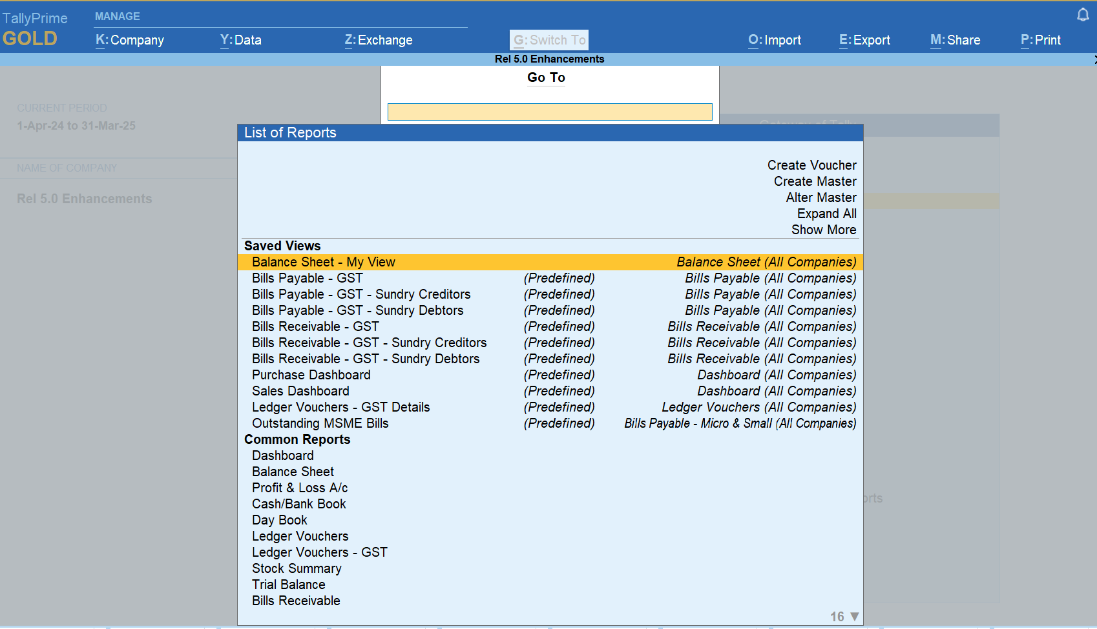
Pre-defined Save view for easy access

Slide 150
GSTR Return activities

Slide 151
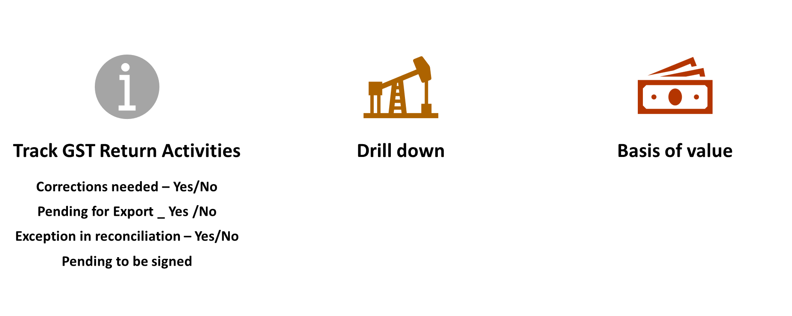
GSTR Track Return Experience
Enhanced GST returns experience
Instant opening of GST returns
All pending tasks are taken care of before return is generated, including spill over from past period
Tracking of pending activities
A preview report to help you review information that will be exported in return

Slide 152
Track GST Return Activities report
Corrections Needed
The GSTR-1 Uncertain Transactions report will open, where you can easily resolve the errors or update the missing details in your GST transactions.
Pending for Export
The GSTR-1 report will open, where you can view the transactions that are pending to be exported, in the Not Exported section under Included in Return. You can easily export the details of your GST transactions for the required period, by pressing Alt + E (Export) > GST Returns.
Exceptions in Reconciliation
The GSTR-1 Reconciliation report will open, where you can easily resolve the Unreconciled transactions or update any missing details.
Pending to be Signed
The GSTR-1 report will open, where you can easily sign the return for the current or earlier periods, by pressing F10 (Sign Return).

Slide 153
GSTR-9 Annual Computation

Slide 154
GSTR-9 – Annual Return to be filed before 31st Dec of every year
GSTR-9 - GST annual returns form to be filed once, for each financial year, by the registered taxpayers who were regular taxpayers, including SEZ units and SEZ developers. The taxpayers are required to furnish details of purchases, sales, input tax credit or refund claimed, or demand created, etc. in this return.
GST Portal will calculate GSTR-9 values in different tables, based on Form GSTR-1, and Form GSTR-3B filed by you. This is available as a download in PDF format and will be auto-populated in different tables of Form GSTR 9 in editable form, except in table no. 6A, 8A, and table no. 9 (Paid through Cash and Paid through ITC).
Details of ITC reversed and Ineligible ITC for the financial year tile to enter/ view the summary of ITC reversed or ineligible during the financial year. GST Annual Computation in Tally provides a detailed report that has GST transactional information as per books. Using this information, you can identify discrepancies, if any, and fill GSTR-9 accurately.

Slide 155
GSTR-9 – Annual Computation
The GST Annual Computation in TallyPrime provides you with a brief view of business transactions recorded during the financial year. The information related to vouchers recorded and financial values from GST applicable vouchers are displayed in separate sections to help you analyze, alter, and finalize details for computation of annual returns.
As most values are pre-filled using the sum of the periodic returns (GSTR-1, GSTR-2, and GSTR-3B). We need to ensure that this sum matches your book values.
By providing the GST Annual Computation report TallyPrime allows you to compare the book values for entire year with uploaded periodic returns.
In case of any deviation in both values, you can make the necessary changes either in your books or in the annual return to ensure that the uploaded returns are true to your book values

Slide 156
Top GST Calls

Slide 157
Value of Supply - Goods / Services Examples
Mr. Rajat sold goods to Mr. Rajesh for Rs. 20,000. Rajat charged packing charges of Rs. 800 and also paid freight of Rs. 2800 to move goods from Rajat’s premises to Rajesh’s premises. Is packing charges or freight required to be included in the invoice to determine taxable value?
Yes, packing charges and freight is required to include in the invoice to determine taxable value
Value of Supply will be Rs. 23,600

Slide 158
Value of Supply - Goods / Services Examples
Ms. Seetha sold goods to Mr. Ram for Rs. 20,000. Seetha allowed a discount of Rs. 2000 at the time of supply. Determine the value of supply for the levy of GST and Value of Supply on which GST to be charged!
Discount is given at the time of supply
Value of taxable supply in the invoice will be giving effect of discount
Rs. 18,000 will be the taxable amount on which GST is levied.

Slide 159
Value of Supply - Goods / Services Examples
Mr. Krishna sold 1000 units of goods to Ms. Radha for Rs. 20,000 and the total units sold during the year to Ms. Radha after including these units is 2500 units. As per terms of the agreement if Radha is purchasing more than 2000 units of goods in a year then Krishna will allow a 10% discount on all the supplies. Assuming the IGST rate is 18%. Will this impact the value of supply, if so how is the discount given will be recorded?
Discount is given post Sales but with Agreement
Yes! The value of taxable supply in the invoice discount will be considered, however
As it posts sales, a credit note will be issued with AV of 5000 and 900 GST there on!

Slide 160
GST Calculations – Scenarios
GST is not getting calculated automatically?
Source of GST and HSN is not in order
Incorrect GST Rate in Taxes and Duties Ledger
Assessee of Other Territory Enabled
Source of GST and HSN Details hierarchy is not in order
GST Ledger Configured Under Indirect Expenses
The same GST Rate calculated / same HSN is shown for all items, WHY?
Incorrect Place of Supply
RCM has been enabled for Ledger or Stock Item

Slide 161
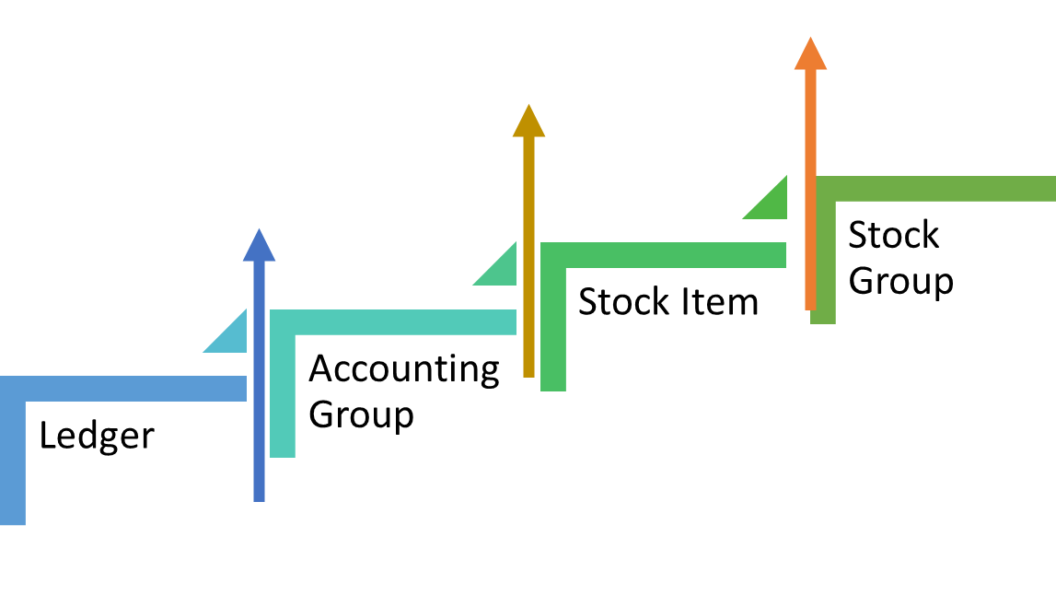
GST / HSNSAC Hierarchy Level below TallyPrime Rel 2.1
HSN/SAC Hierarchy
GST Hierarchy

Slide 162
GST / HSNSAC Hierarchy Level below TallyPrime Rel 3.x onwards
GST Hierarchy + HSN/SAC Hierarchy
Independent, but has similar hierarchy pattern

Slide 163
GST / HSNSAC Hierarchy enhanced post 3.x onwards
In Release 3.x onwards Tally helps to decide the order in which user want to apply the rates. You can select either the ledger or the stock item as the primary source for applying GST rates based on your business need, and choose one of the following two orders:
Service business or not maintaining Inventory, can opt for the Ledger hierarchy
Traders or Manufacturers maintaining complete Inventory can opt for the Stock Item hierarchy
Ledger
Accounting Group Stock Item
Stock Group
Company
Based on business need
Stock Item
Stock Group
Ledger
Accounting Group
Company

Slide 164
GST Calculations – Scenario 1/6
The source of GST and HSN is not in order
Know the business
Understand the business usage – Nature of business? Inventory used?
How to fix it?
GST Tax analysis
Refer GST Tax Analysis to understand the source – clarify source is been rightly configured!
Configuring default hierarchy in F11: Set / Alter GST Details > Additional Configuration > Source of GST rate/ HSN details in transactions
Defaulting Hierarchy

Slide 165
GST Calculations – Scenario 2/6
Incorrect Place of Supply
The Place of Supply is the state or place of the party that avails the Input Tax Credit (ITC), which is the buyer in most cases. When you override the Place of Supply manually for any reason, you will need to select the relevant IGST or SGST and CGST ledgers.
A
Possible Cause
GST Tax Analysis > Refer to the Party details screen for the state information and Duty calculated!
B
Resolution

Slide 166
GST Calculations – Scenario 3/6
Incorrect GST Rate in Taxes and Duties Ledger
Possible Cause:
GST rates are considered from the Stock Item and then the Sales or Purchase Ledger. When GST ledgers under Duties & Taxes, have specified GST rates in the ledger, and . when we use those ledgers in a voucher along with the stock items in which the rates are specified, GST does not get calculated due to conflicting GST rates in the master.
Resolution:
Use Common Ledger or GST Rates configured as per stock item masters

Slide 167
GST Calculations – Scenario 4/6
Assessee of Other Territory Enabled
Possible Cause: If an assessee of another territory is enabled, then IGST is applicable. However, when the user selects SGST and CGST ledgers considering the local party, then GST does not get calculated.
Resolution: If GST is not calculated for any vouchers even though the hierarchy is proper, then check in F11 GST details > whether Assessee of Other Territory is enabled, if so disable the same!
If it is happening for a specific party, check GST Tax Analysis > Refer to Party details screen Place of supply will be shown “Other Territory”.
The party is Local and needs to charge CGST+SGST, then disable “Assessee of other territory in Party Master
If the Party is from Assessee of Other territory, then charge IGST

Slide 168
GST Calculations – Scenario 5/6
GST ledger created under Indirect Expenses
Possible Cause:
Resolution:
Ledger for GST, be it SGST, CGST, or IGST, you need to create it under Duties & Taxes so that the GST gets calculated during voucher creation and the tax amounts appear correctly in all the GST reports. However, when you create the ledger under Indirect Expenses, GST does not get calculated.
Ensure that the ledger belongs to the Duties & Taxes group.

Slide 169
GST Calculations – Scenario 6/6
RCM has been enabled for Ledger or Stock Item
Possible Cause: If the accounting ledger or stock item used has been configured with RCM, wherein the recipient of the goods/service is liable to pay tax, hence GST will not calculate automatically.
Check whether “Amount of Tax Subject to reverse charge” is shown in Tax Analysis.
Check whether it’s an RCM transaction if “Yes” then GST will not calculate
If the “Source of GST Rate details. If Stock item – Go to Stock item master disable RCM with a proper applicability date
If No, then check;
If the “Source of GST Rate details. If Ledger – Go to Ledger master disable RCM with a proper applicability date (if required create New Common Sales Ledger)
Resolution:

Slide 170
GST Calculations – Scenarios
The same GST Rate calculated / HSN is shown for all items, WHY?
Possible Cause:
Resolution:
Service business or not maintaining Inventory, you can opt for a Ledger hierarchy
b. Traders or Manufacturers who maintain a complete Inventory can opt for the Stock Item hierarchy
Ledger > Accounting Group > Stock Item > Stock Group > Company
The source of GST and HSN Details hierarchy is not in order
Check GST Tax Analysis to know the needs of customers and then based on his business segment i.e..,
Stock Item > Stock Group > Ledger > Accounting Group > Company

Slide 171
Record Stock Transfers or Branch Transfers
To record stock transfers or branch transfers in case of transfer of material from one branch to another. In such cases, GST applicability depends on whether the receiving branch has the same GSTIN or a different GSTIN.
Stock transfer across branches includes scenarios such as:
Transfer of goods to another branch (including godown to godown) based on the demand
Transfer of finished goods to godown or warehouse for further supply or distribution
Transfer of semi-finished goods from the manufacturing unit to another unit for further processing
Local transfer to a branch with same GSTIN – Record Receipt / Delivery Note
Interstate outward / inward branch transfer – Record Sales / Purchase with GST applicability

Slide 172
GSTR-1 Filing – Scenarios – This is solved in 5.0
Why Marked for Deletion on the Portal shown in GSTR-1 and how do we remove it?
The Marked for Deletion on Portal section of GSTR-1 provides an overall picture of the vouchers that have to be deleted from the portal, due to any changes in the transactions in your books. For such transactions, this section will help in identify the original entry on the portal so that you can re-upload the transaction with the revised details. In some cases, the transactions might accidentally appear in this section due to some changes in the transaction details which can be easily addressed in the below scenarios
In Release 5.0, we have given reset delete request option for user to remove which is applicable for Transactions and not for Summary details
Change in Party / Party GSTIN
Uncertain Transactions > Mismatch in GST Master and Transaction / GST Registration details.
Deletion of transactions from books
Validate whether return has been fixed and its not valid, then delete it
Change in GST amount
Mismatch between the expected tax amount and the modified tax amount in transactions
Change in company GSTIN
Uncertain Transactions > Mismatch in GST Registration details between the GST registration master and the transactions or in cases wrongly specified then show GST registration details of the company are invalid or not specified
Change in voucher number
Voucher number will appear blank

Slide 173
GSTR-1 Filing – Scenarios
Mr Anand had recorded both GST and non-GST items in a single invoice, however, in GSTR-1 it is considering only the value of GST items. Why?
Invoices containing only non-GST items will be recorded in Section 8 of GSTR-2 and Section 3.1e of GSTR-3B. On the other hand, if an invoice contains both GST and non-GST items, then only the value of GST items will be considered in GST returns.
GST goods impact
GST and non-GST goods or services cannot be recorded in the same invoice. User has to maintain separate invoices for regular taxable goods and non-GST goods (such as Petroleum products and Alcohol for human consumption
Non-GST Goods
The value of non-GST items will be included in the total invoice value but excluded from tax calculation.

Slide 174
GSTR-1 Filing – Scenarios
Yash Enterprises is filing their Monthly GSTR-1 return, and getting the error “File couldn’t be uploaded, download the latest offline utility file”. What is the cause and how do we troubleshoot it?
Data Readiness
Ensure all uncertain exceptions has been resolved and the right values have been participated in GSTR-1 Tables
HSN Summary
Ensure a 6-digit HSN/SAC code has been mentioned for all Inventory masters if the turnover is >5Cr
Document Summary
Displays the transaction count of voucher type used for each nature of documents recorded during the return period and has voucher number From & To
If the user has not provided HSN at each item master level and performs accept as is or the HSN summary for said master has negative values, then the HSN summary needs to be excluded while generating GSTR-1 and uploading the HSN summary on the portal manually.
Validate GSTIN
In the case of manual voucher numbering, wherein the user might have given numbering as per their need and not in sequence, then the document summary can be excluded and uploaded manually on the portal.
Ensure the HSN number is of even digits 2,4,6, or 8 as per the Business turnover, so that valid HSN has uploaded
Validate Buyer GSTIN before generating GSTR-1 to ensure their GSTIN is not inactive or cancelled as their transaction reporting need to be moved to B2C. Using Online GSTIN validation facility using e-way bill or e-Invoice credential to validate the data.

Slide 175
GSTR-1 Filing – Scenarios
Cause
Microsoft Office treats capsule files from TallyPrime as unsafe and prevents export to MS Excel.
Solution 1
Upgrade to the latest MS Office version on your computer
Solution 2
Change the Trust Center settings in MS Excel to mark TallyPrime as safe in order to resolve the issue.
Open MS Excel > File menu > Options tab > Click Trust Center in the pop-up window that appears, and then click the Trust Center Settings button > Add new location button > enter path of TallyPrime with all subfolders > Save the settings.
Unable to Export GSTR-1 returns to MS Excel or getting error you need to add Tally prime installation folder as a trusted location in your MS- Excel."

Slide 176
GSTR-1 Filing – Scenarios – This is resolved in 5.0
Mr. Dinesh is trying to export GSTR-1; however, the preview is showing blank and unable to export. What is the reason and how do we resolve it?
Possible Reason
Data is already exported through JSON or Excel format, or the Voucher listed in the Uncertain Transactions report!
Resolution
Go to GSTR-1 and check “No action required” has a voucher count.
If No, then check whether the transactions are listed in Uncertain Transactions (Correction Needed)
If Yes, then click on Export GST Return > in the preview > Ctrl+B: Basis of value – enable Include transactions where no action is required and export GSTR-1
While the given steps hold good in Release 5.0, we have additional given any option like exclude / include returns in GSTR-1 preview

Slide 177
GSTR-1 Filing – Scenarios
Mr. Rajesh is a quarterly return filer and trying to export GSTR-1, however, only B2B section is getting exported! What is the reason and how do we resolve it?
In case of return type is configured as quarterly in F11: company features, then B2B invoices and credit notes related table gets exported for 1st two months of the quarter.
Check whether the customer has enrolled as a quarterly filler;
If Yes – Supplier registered under the Invoice Furnishing Facility (IFF) provision can export B2B invoices and the credit notes-related table gets exported for 1st two months of the quarter, so that buyers can claim the Input Tax Credit in the first and second months. In the third month, file GSTR-3B and GSTR-1, as usual with all sections
If No – take a backup of data & configure the return type as “Monthly” and try exporting GSTR-1 Return.
Possible Reason
Resolution

Slide 178
GSTR – 2A/2B Recon
National traders maintains all his tax invoice with decimal value and issued Tax invoice to Mr. Ranjan for Rs. 12920 with IGST of 2325.60 (18%). However, Ranjan maintains all his invoice with rounded value. During reconciliation it showed difference in the Tax Amount for a transaction in his book vs on the portal. How to resolve and reconcile the same?
Modify the Tax amount manually to decimal value
OR
Reconcile the status manually by pressing Alt+S (Set GST Status)
Reconciled

Slide 179
GSTR – 2A/2B Recon
M/s Aru International was not able to find his purchases done from National traders, as they failed in filing their GSTR-1 returns. As these transactions were not auto populated in GSTR-2B, how to reverse those entries and avail ITC for next month.
As there is a mismatch in the return period between the books and the portal
We need not reverse and account it in next month.
For such transactions, you can simply update the GST Return Effective Date in your books, by pressing Alt+L (Set Effective Date).

Slide 180
GSTR – 2A/2B - Potential matches (Excluding Section)
M/s Suraj enterprises was not able to find his purchases done from Damayanti traders. Damayanti Traders had recorded a Credit note for reducing the purchase price and same was uploaded to portal, while M/s Suraj Enterprise has recorded purchase voucher type. How to resolve this and reconcile.
In GSTR 2B Recon > F12 > enable the option Show potential matches between Books and Portal.
In Suraj Enterprise this transaction will be shown Potential matches (Excluding Section)
Resolve this difference in Section updating the voucher type - Update the voucher type from Purchase to Credit Note by pressing Alt+F10 (Other Vouchers) > Credit Note.
Update reason for Issuing Note, Supplier’s Debit/Credit Note No., and Date.

Slide 181
GST Amendments Scenario 1
M/s National Traders have filed their GSTR-1 return for Feb’24 and later realized a data entry error in the Amount field. How do we rectify this entry?
The Return Effective Date in TallyPrime
If there is a data entry error in the Amount field or the total amount of the invoice, then you will need to amend the invoice with.
01
03
02
New amount will appear against the effective date in GSTR-1 in the subsequent month
In GSTR-3B, the difference between the amounts will reflect in the subsequent month.

Slide 182
GST Amendments Scenario – Inward Purchase
M/s Ratan Enterprises got an amended Invoice, wherein they had already filed their GSTR return. How do we rectify this entry?
1
2
3
The Return Effective Date in TallyPrime
4
01
GST Amendments for Inward Supplies with Effective Date
Mark the voucher to be amended as counterparty signed in TallyPrime.
03
02
New amount will appear against the effective date in GSTR-1 in the subsequent month
Make the required changes in the invoice
Amend the voucher by providing the Return Effective Date
In GSTR-3B, the difference between the amounts will reflect in the subsequent month.

Slide 183
Release 5.0 FAQ’s

Slide 184
Scenario 1
M/s Suraj Enterprises reconciled data and observed that few entries were shown in available in portal, wherein he had missed out recording the same. Now he wanted to convert the said entries automatically? Is it possible to do so, if No, why?
No, as Download data from the GST portal have several limitations
Data is consolidated GST rate-wise and does not provide breakup of items//ledgers of same rate.
HSN information is not available in individual vouchers downloaded.
Information of item rate / quantity are not available which are required to create a ‘complete’ purchase in books.
Additional information needed (party and duty ledgers, purchase ledgers, cost centre/batch information etc.) have to manually fed, making automation very limited.

Slide 185
Scenario 2
In 5.0, we have provided complete filing of GSTR-1, why the same is not supported for GSTR-3B?
GSTR-3B return filing is a multi-step activity involving primarily below steps:
Upload GSTR-3B, Transfer funds to e-ledgers, Setoff liability using ITC and Cash
The step of Transferring funds from a Bank account to an e-ledger account is very critical to 3B return completion, however lack of Challan generation and Fund transfer APIs by GSTN has prevented Tally or any GSP to provide and end-to-end return filing solution. Hence, after step-1 (upload GSTR-3B) it is more convenient to perform all the remaining steps on GST portal. A partial solution (Step 1 and 4 in Tally but Steps 2 and 3 on portal) will not be of any help.
Will support end-to-end return filing from Tally as and when the said APIs are made available by GSTN for integration

Slide 186
Scenario 3
M/s Reliance Business has multiple branches within Karnataka with single GSTIN, is it possible to create all branch address using Fetch GSTIN/UIN?
No, this requires an experience design that will allow you to easily browse 100s of branch addresses and select one or more address among them to create multi-address for the ledger.
Until the experience of browse and select multiple address and create is not solved comprehensively (considering single and bulk ledger creation scenarios) it will become a cumbersome exercise in comparison to manual creation
Also typically ledger is created with 1 address at beginning and as business expands, branches get added rather than creating ledger on the first instance itself with multiple branches. We will be working on streamlining the experience and deliver this feature.

Slide 187
Scenario 4
Mr. Span India, upgraded to Release 5.0 and found File GSTR-1 option in Alt+Z: Exchange. Now without uploading, downloading and reconciling, directly clicked and File GSTR-1? What happens, if upload or download is not done?
When user clicks on File – GSTR-1, system warns with a message as “Certain Transactions are in uncertain or pending to be uploaded. Uncertain will not be included in the return, YES / NO
If user selects Yes – it will still warn that NIL return is getting upload and if he proceed NIL Return gets filed
Note: Once return gets filed there is no provision to undo it. User has to file GSTR-1A for uploading B2B transactions and other summary for the upcoming months

Slide 188
Scenario 5
Mr. Ratan Enterprises, is a quarterly return filers and are trying to file 1st month of OND’24 quarter using Release 5.0. While uploading October return data, in portal it is showing blank and data shown in November, how to resolve this?
While filing GSTR-1 for October’24 > in GSTR-1 > Alt+Z : Exchange > Upload GST Return > Press F12 > Enable Consider report period instead of return filing period for online upload > save and try to upload the return again

Slide 189
Need to train on Release 5.0 FAQ’s
https://help.tallysolutions.com/tally-prime/india-gst/india-gst-faq-tally/
https://help.tallysolutions.com/tally-prime/india-gst/gst-errors-and-resolutions/
https://help.tallysolutions.com/tallycare-assist/credible-response-for-connected-gst/

